Slide 1
Freshwater ecosystem management and practice in Thailand
Launching Ceremony of Lancang-Mekong Evironmental Cooperation Center and Supporting Meetings
November 15-17, 2017

Slide 2
Introduction
The Environment Programme of the Mekong River Commission (MRC) has monitored the ecological health of the Mekong river-system by using biological indices since 2003
The representatives of the NMCs and line agencies together with national experts and international consultants developed a program and selected appropriate methods and procedures for Ecological Health Monitoring (EHM).

Slide 3
objectives
Conduct the monitoring and evaluate ecological health of the Mekong River in Thailand part by using benthic diatoms, zooplankton, littoral macroinvertebrate and benthic macroinvertebrate and to identify the species, richness and relative abundance of four organisms along the Mekong River and tributaries of the Mekong River catchments in Thailand part.
Determine the physical and chemical parameters as the ecological health condition at the selected sampling sites in Thailand.
Disseminate biomonitoring methodology and the knowledge of ecological health implementation program to wider stakeholders

Slide 4
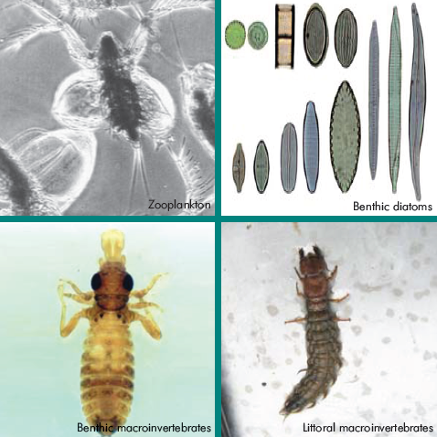

Slide 5
SAMPLING SITES
Site TNP (Thailand Nakorn Panom), Mekong River at Nakorn Panom Province
Site TSM (Thailand Songkarm Mount), Mekong River at the connection between Songkram River and Mekong River.
Site TNK, (Thailand Nam Kham River), Nam Kham River at the Mukdaharn Province.
Site TMU, (Thailand Mun River), Mun River at the Kong Chiam District, Ubonrachathani Province.
Site TKC, (Thailand Kong Chiam), Mekong River at the Kong Chiam District, Ubonrachathani Province.
Site TUN, (Thailand Ubon New), Mun River at the Ubonrachathani Province.
Site TCS, (Thailand Chiang San), Mekong River at the Chiang San District, Chiang Rai Province.
Site TKO, (Thailand Kok River), Kok River at the Chiang, Chiang Rai Province.

Slide 7
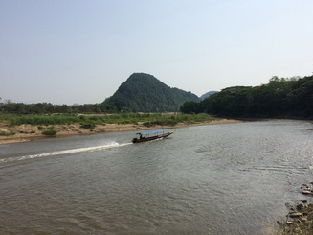
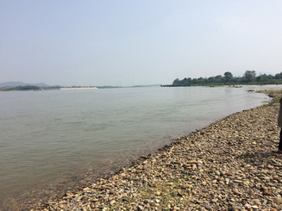
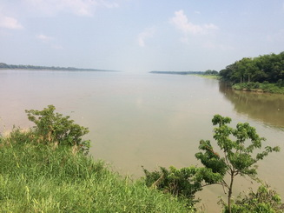
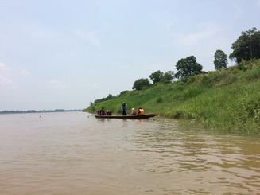
TKO, Thailand Kok River
TCS, Thailand Chiang San
TSM, Thailand Songkarm Mount
TNP, Thailand Nakorn Panom

Slide 8
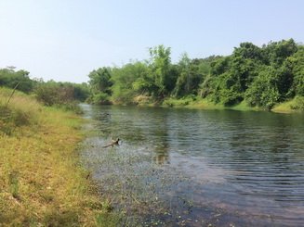
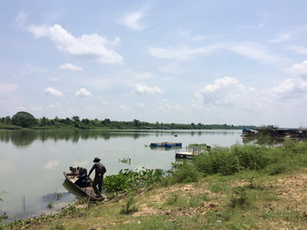
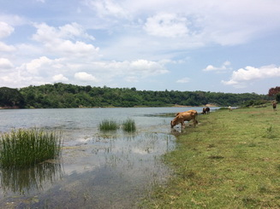
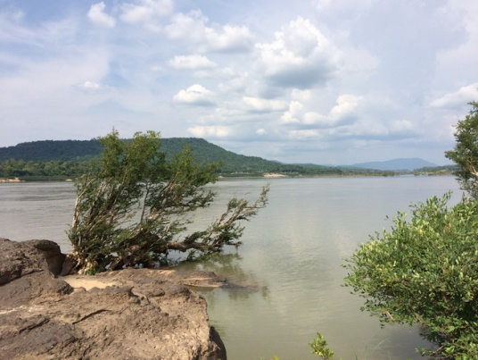
TNK, Thailand Nam Kham River
TUN, Thailand Ubon New
TMU, Thailand Mun River
TKC, Thailand Mekong River

Slide 9
Scope of EHM
Measure water quality parameters that include DO, pH, Conductivity and water transparency at the sampling sites.
Collect biota samples of zooplankton, benthic diatoms, benthic macroinvertebrates and littoral macroinvertebrates at the sampling sites.
Habitat assessment and classification based on visual assessment and scoring of the surrounding landscape at each selected site.
Preserve and transport biota samples.
Conduct laboratory work for biota sample procedure.
Identify all biota specimens of the collected samples.
Quality Assurance and Quality Control (QA/QC) system is required to apply for sampling, handling, transport, storage, analytical methods and data reporting.
Provide water quality and biological data, and habitat assessment and scoring.
Analysis and interpret all data and information of water quality and biological data of each study site, and site classification.

Slide 10
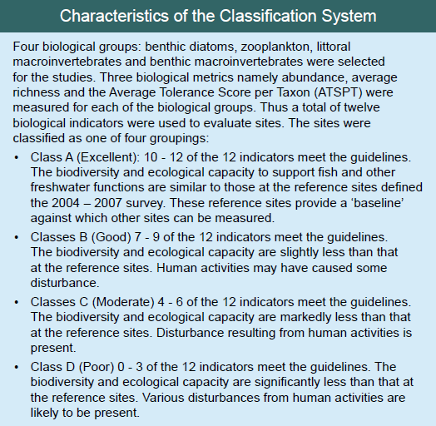

Slide 11
Outputs
Water quality and biological data stored in a formatted database that was developed in 2004.
The photos representative of each species requested recording
Field survey report, laboratory work report, and final report.

Slide 12
Thank you

