Slide 1
ຍິນດີຕ້ອນຮັບສູ່ ສປປ ລາວ!
Welcome to Lao PDR!
Presented by: Laos’ Delegations,
Ministry of Natural Resources and Environment Vientiane, Lao PDR
15-17 Nov 2017
Beijing, China
The Lancang-Mekong Countries and the UN 2030 Agenda for Sustainable Development

Slide 2
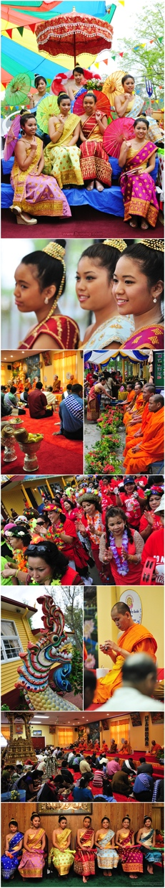

Contents
Introduction to Lao PDR: Socio-economic Information
National Policy and Strategy on Environment
Implementation of Environment-related SDGs in the Lao PDR
  - MONRE’s Efforts toward the SDGs
Conclusion
Recommendations

Slide 3
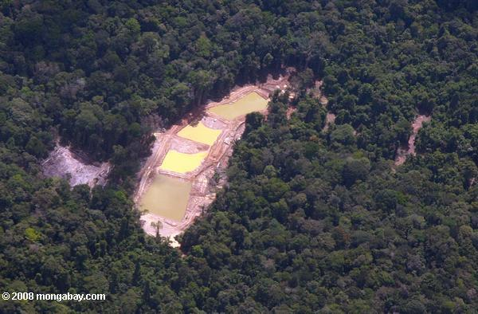
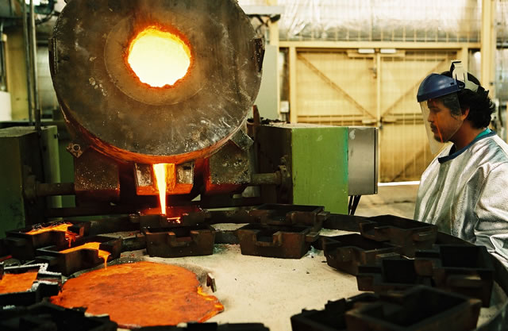
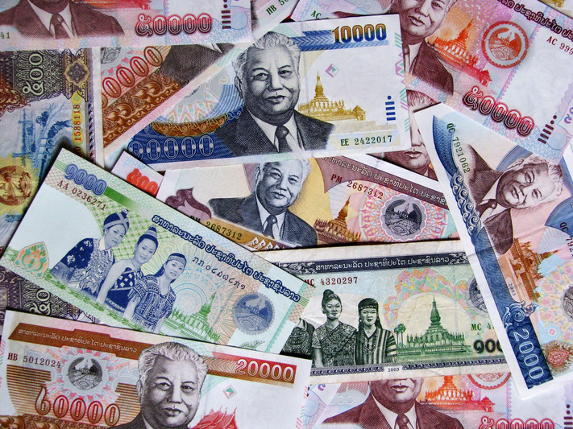
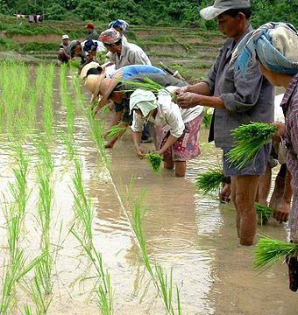
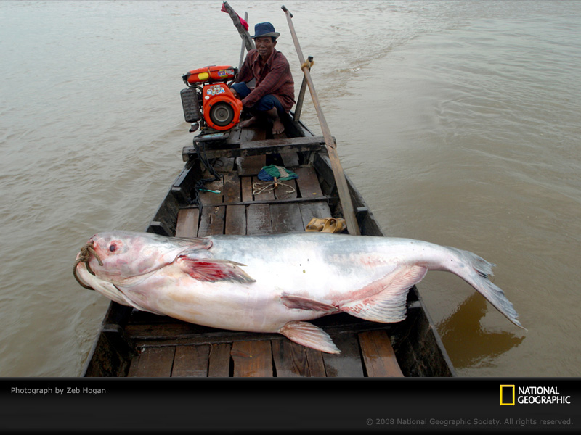
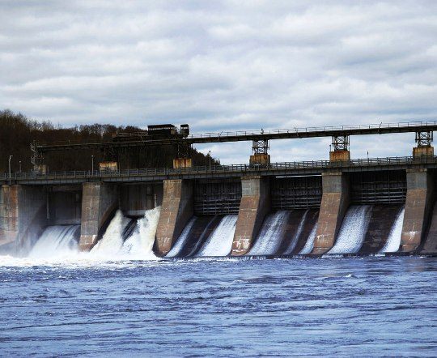
- Currency is Lao Kip (LAK) – US$ 1 ≅ LAK 8,000.00
- GDP Growth Rate = 6.8% (1st half of 2017)
- Income Per-capita = US$ 2,353.2 (2013-14)
- GDP Shares by Sectors (2014-15) = 23.7% Agriculture & Forestry
29.1% Industry
47.2% Tourism & Services
1. Introduction to the Lao PDR:
Socio-Economic Information (cont.)
Source: The 10TH General Congress of the Lao People’s Revolutionary Party

Slide 4
2. National Policy and Strategy on Environment
  In 2011, Ministry of Natural Resources and Environment (MONRE) of the Lao PDR was officially established (switched from WREA to MONRE), focusing on 2 main sectors:
    Natural Resources Sector: Sustainable Management of Natural Resources;
    Environmental Sector: Environmental Quality Protection.

Slide 5
2. National Policy and Strategy on Environment
(cont.)
In the 10TH General Congress of the Lao People’s Revolutionary Party, held on 18-22 January 2016 in Vientiane, Laos, 3 significant goals have been set to guarantee Green & Sustainable Development by 2030.
  One of those goals is, “Securing the most effective & efficient use of natural resources & environmental protection in the direction of green & sustainable development; effective preparedness for natural disasters & adaptation to climate change”.
  Followed by the 8th Five-Year National Socio-economic Development Plan (2016-2020) of the Government of Laos, known as “The 8th NSEDP”, to archieve the above-mentioned goals & SDGs.
      Outcome 1: Macro economic..
      Outcome 2: Social & Cultural...
    Outcome 3: Environmental Protection and Sustainable Natural Resource Managment
          Output 1 – Environmental Protection & Sustainable Natural Resources Management
          Output 2 – Preparedness for Natural Disasters & Risk Mitigation

Slide 6

Natural Conservation & Environmental Protection in Laos
MONRE was established in 2011
Environmental Protection Law (EPL)
issued out in 1999 and revised in 2012
Latest update (2015)
Legal Frameworks:
(Legislation, Decrees…)
1st Five-Year Action Plan 2006-2010
National Strategy on Environment 2006-2020
2nd Five-Year Action Plan 2011-2015
Vision toward 2030
National Strategy on Natural Resources & Environment 2016-2025
3rd Five-Year Action Plan
2016-2020

Slide 7

MONRE’s Vision toward 2030
Concept of
Sustainable Development
“Green, Clean, and Beautiful Laos with the richness of natural resources on a basis of Green Economic Development to reach the Sustainable Development and Industrialization in parallel to
Climate Change Adaptation and Disaster Resilience.”

Slide 8
The 3rd Five-Year Action Plan (2016-2020)
National Strategy on Natural Resources & Environment (2016-2025)
Overall Goal: “Green, Clean, & Beautiful Laos on a basis of Green Economic Growth in order to ensure Sustainable Development, Climate Change Adaptation, & Disaster Resilience”
Core Targets:
  Land Management Program
  Water Resources, Meteorology & Hydrology Management Program
  Environmental Protection & Climate Change Program
  Regional & International Integration & Cooperation Program
  Institutional Capacity Development Program
2016
2025
Vision 2030
2020
3rd Five-Year Action Plan (2016-2020)

Slide 9
The 3rd Five-Year Action Plan (2016-2020)
National Strategy on Natural Resources & Environment (2016-2025)
3rd Five-Year Action Plan (2016-2020)
Focus Projects (2016-20)
  Environmental Quality Promotion Projects (e.g. ESC, ISP, SEA, EMH, Environmentally Friendly Technology Promotion, Environmental Education)
  Pollution Monitoring & Control Projects
  EIA, Management & Monitoring of Investment Projects
  Climate Change Adaptation & Disaster Risk Reduction Projects
Core Targets:
  Land Management Program
  Water Resources, Meteorology & Hydrology Management Program
  Environmental Protection & Climate Change Program
  Regional & International Integration & Cooperation Program
  Institutional Capacity Development Program

Slide 10
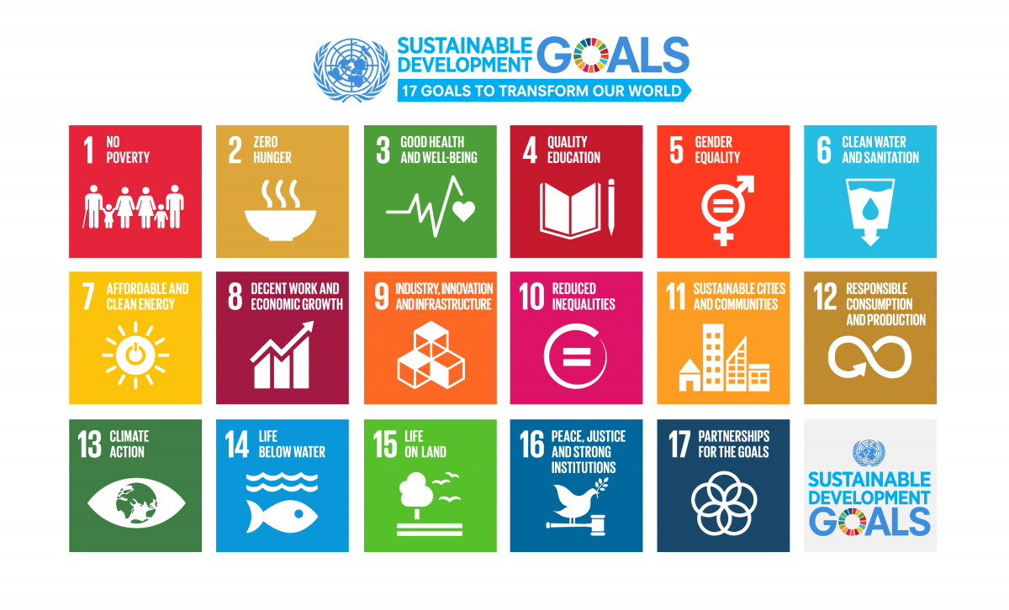

3. Implementation of Environment-related SDGs in the Lao PDR

Slide 11
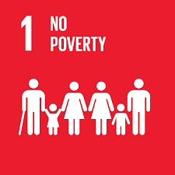
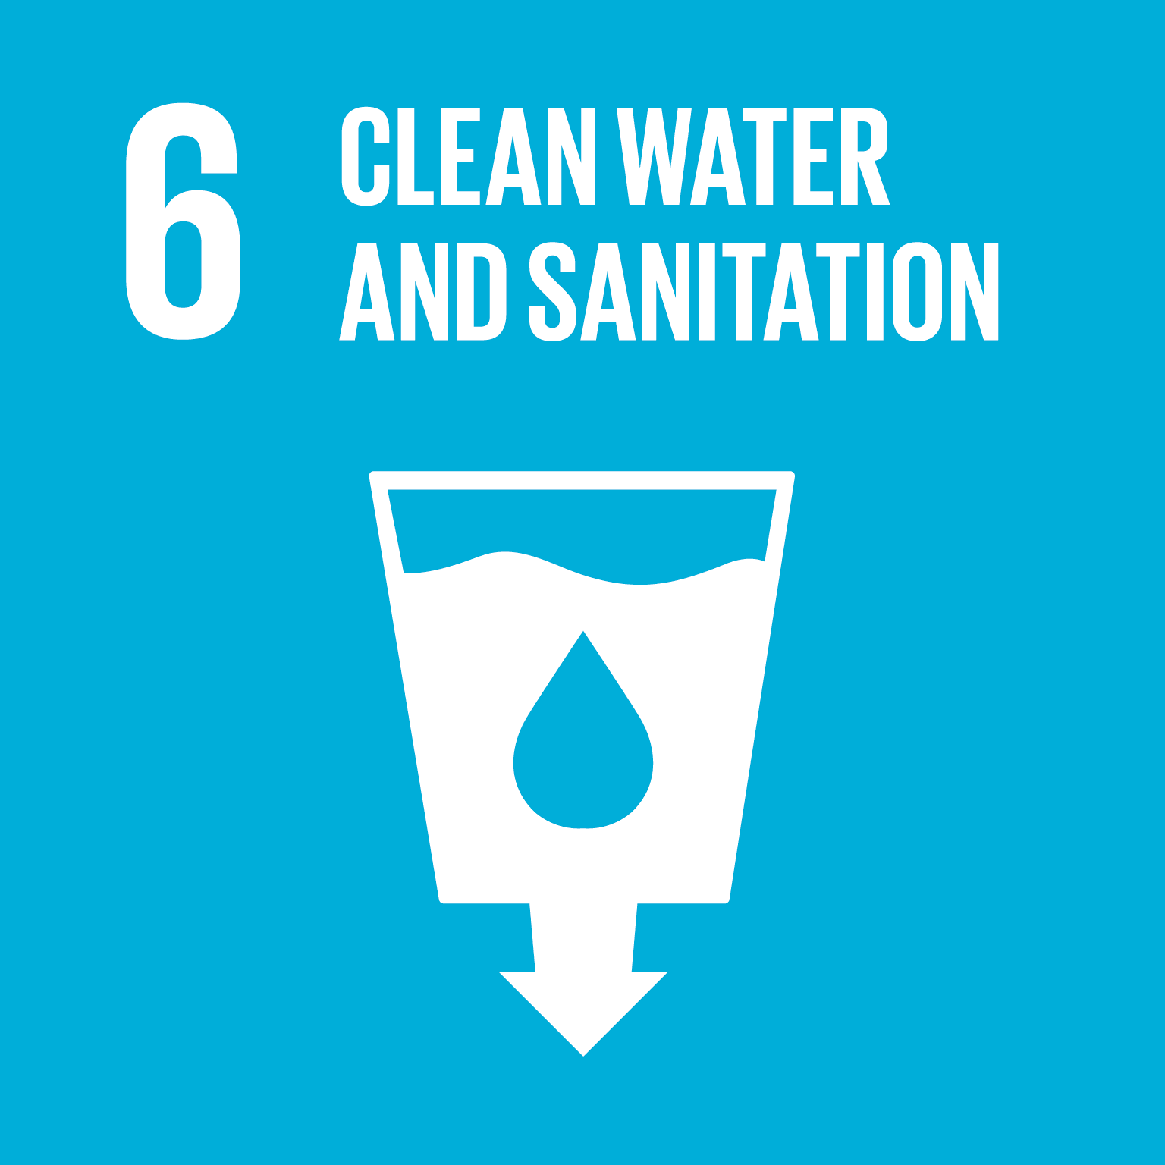
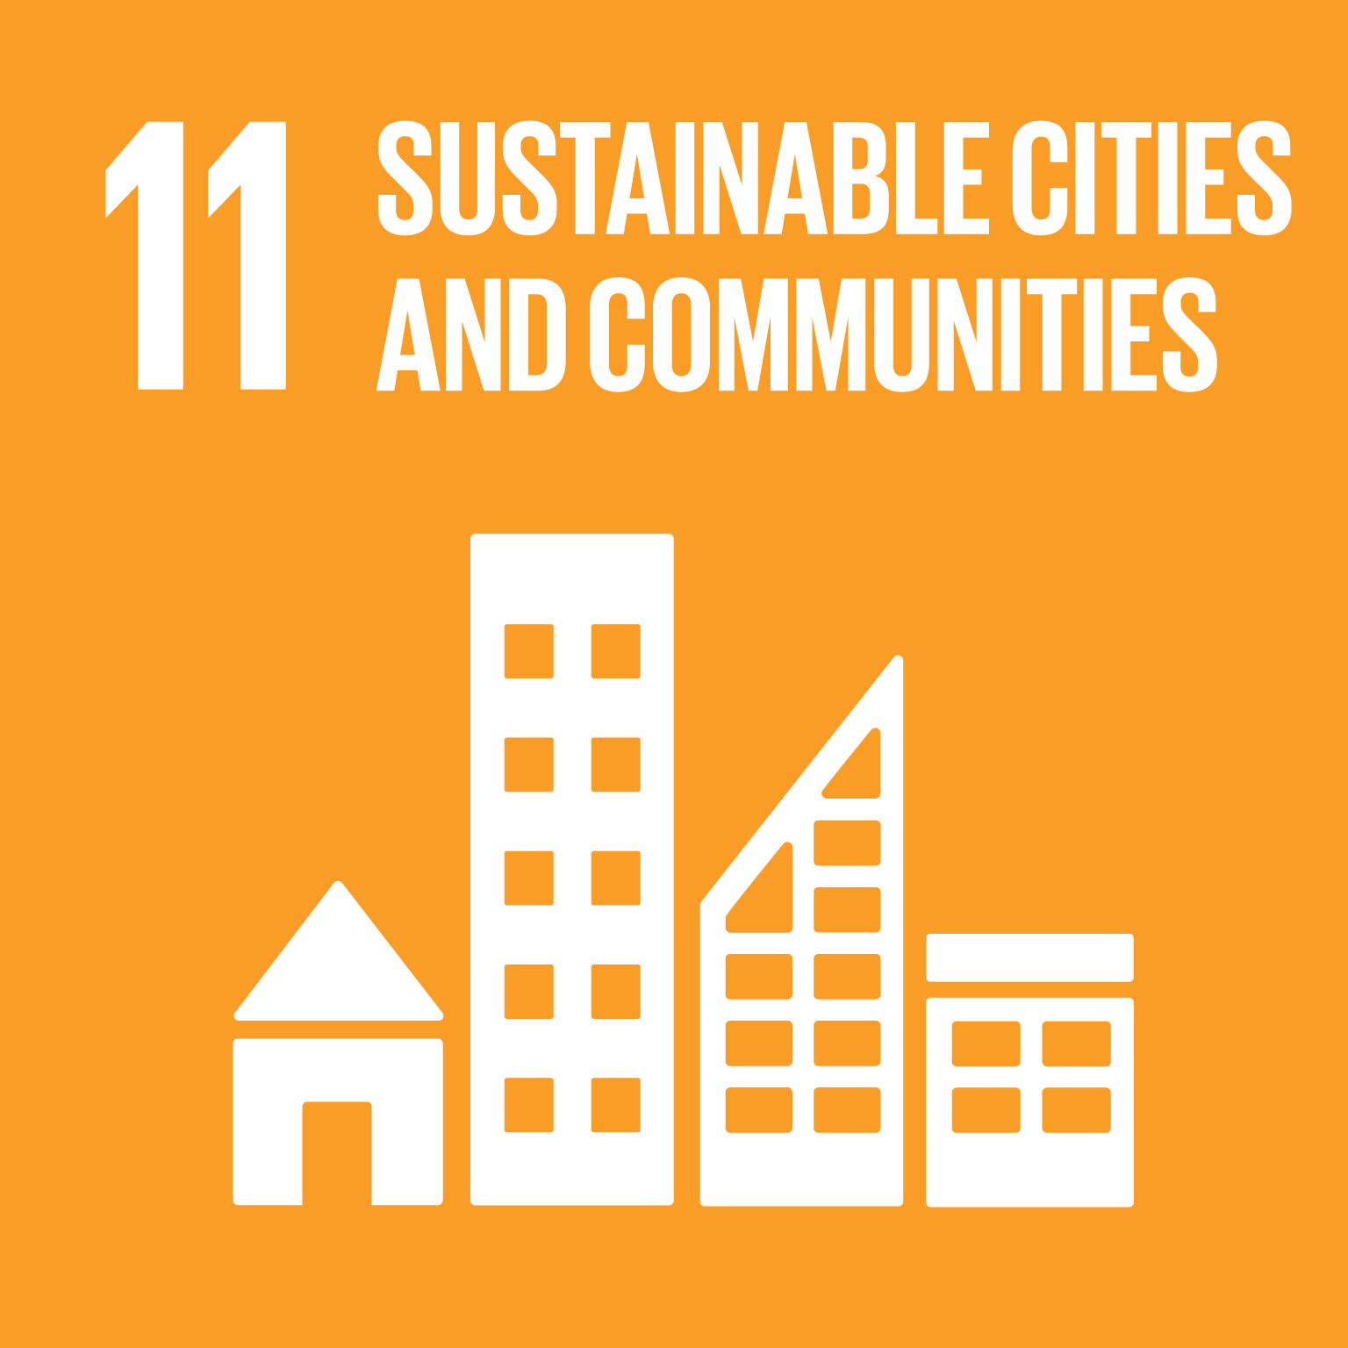
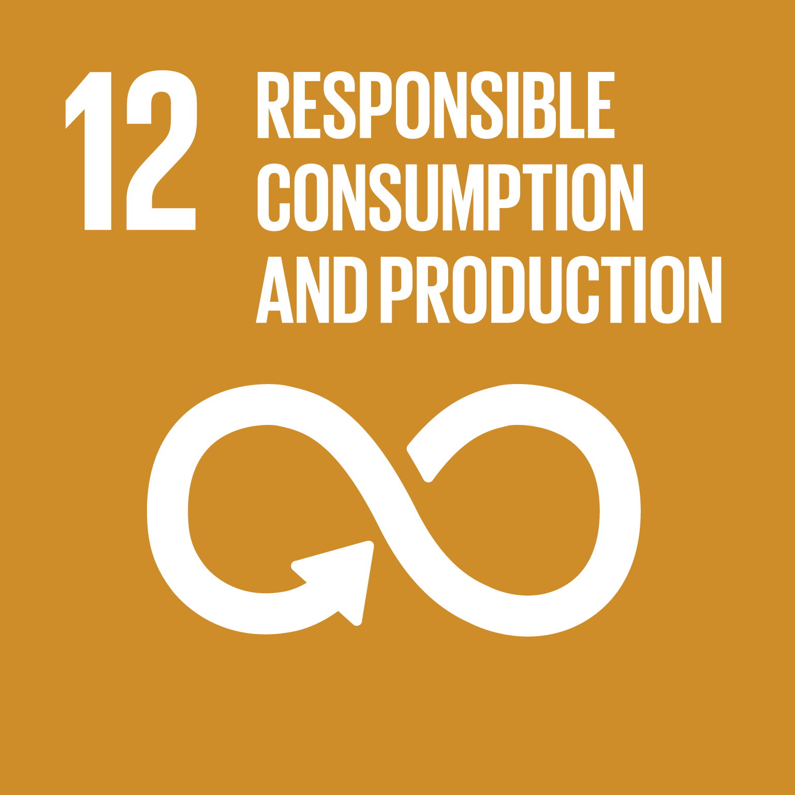
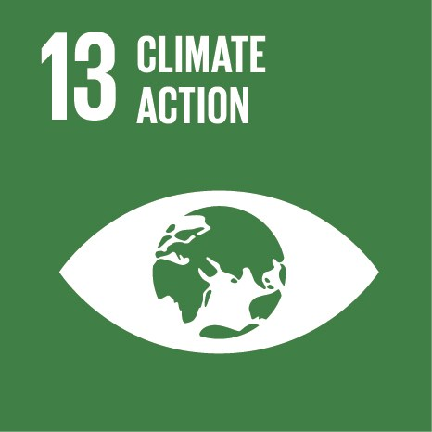
3. Implementation of Environment-related SDGs in the Lao PDR (cont.)
Ministry of Planning and Investment is now drafting the Roadmap toward SDGs;
On March 29, 2017, MONRE acceded 5 SDGs with 19 targets and 28 indicators for sustainable development in Natural Resources and Environment, including:

Slide 12
3. Implementation of Environment-related SDGs in the Lao PDR (cont.)
MONRE’s Efforts toward SDGs
3.1 Devising and enforcing Laws, Regulations, and Legal Framework on Natural Resource Management and Environmental Protection;
3.2 Implementation of the 3rd Five-Year Action Plan (2016-2020)

Slide 13
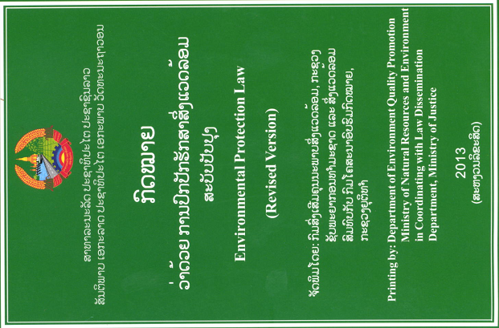
3.1 Devising and Enforcing Laws, Regulations, &
Legal framework
Mekong Agreement 1995
Environmental Protection Law (first edition in 1999 & last update in 2012)
Agreement on the Environmental Standards (2010), updated in 2017
Decision on the Ozone Depleting Substances Management (2012)
Ministerial Agreement on the Endorsement and Promulgation of List of Investment Projects and Activities Requiring for Conducting the IEE or ESIA (2013)
Agreement on Boiler Management in Processing Industry & Handicraft (2014)
Agreement on Air Pollutant Emission Control in Processing Industry (2015)
Guideline for Toxic & Hazardous Waste Management (2015)
Guideline for Pollution Control (2015)
Lao PDR’s Intended Nationally Determined Contribution (Lao PDR’s INDC) has been submitted to UNFCCC COP-21 on September 30, 2015
Ministerial Agreement on Strategic Environmental Assessment (SEA)
Notes:
Lao PDR’s Intended Nationally Determined Contribution (Lao PDR’s INDC) = ບົດລາຍງານແຫ່ງຊາດ ກ່ຽວກັບ ການປະກອບສ່ວນເຂົ້າໃນການແກ້ໄຂບັນການປ່ຽນແປງດິນຟ້າອາກາດ

Slide 14
On-going Process: Strategy and legal framework
Development of Environmental Pollution Control Strategy;
Draft Provision on Environmental Tax;
Draft Environmental Standard and Guideline for Green, Clean, Beautiful Laos;
Updating the ministerial agreement on technical services on environment;
Etc...
Notes:
Lao PDR’s INDC ບົດລາຍງານແຫ່ງຊາດ ກ່ຽວກັບ ການປະກອບສ່ວນເຂົ້າໃນການແກ້ໄຂບັນການປ່ຽນແປງດິນຟ້າອາກາດ

Slide 15
3.2 Implementation of the 3rd Five-Year Action Plan (2016-2020)
On-going projects in 2017
  58 projects countrywide in 3 sub-sectors (Land, Water and Environment),
  26 foreign-financed projects,
  3 Lao-contributed projects,
  29 Lao-financed projects.
Projects by sectors
  9 projects under Land Sector,
  11 projects under Water and Hydro-meteorology Sector,
  21 projects under Environment, Disaster Risk and Climate Change Sector.
  17 projects under cross-cutting sectors, supporting institutional change, monitoring, & human capacity building.

Slide 16
3.2 Implementation of the 3rd Five-Year Action Plan (2016-2020) (cont.)
Key achievements in the first half of 2017 – Land Sector
      47,450 Land titles issued with nationwide equivalent to 55.8% of the annual plan and registered into the computer system by using LLMS for drawing and printing for 6,891 partials,
      The information has input into the database for 69,471 partials;
      Conduct the data collection for expansion of land price assessment in 2 northern provinces (4 districts of Luang Namtha and 3 districts of Bokeo Province). 3 districts are under data collection preparation process.

Slide 17
3.2 Implementation of the 3rd Five-Year Action Plan (2016-2020) (cont.)
Key achievements in the first half of 2017 – Water
      Completed the amendment of technical guidelines on GIS for Water Resource Management and completed water resource model as the pilot for Development Planning in Nam Song sub-water basins including conducting research and improving 8 draft regulations on water resource management;
      Implementing data collection for risk assessment and some activities under Sedon and Nam Ngeum river basins management plan, together with summarizing water resource, quality and quantity assessment from concerned bodies in 2 water receivers. Completed 80% of Xe bangheang and Xe bangfai basin management plan including initiate some activities in the plan;
      Completed the development of Nam Ou basin general situation report and dissemination meeting at the end of June 2017; and continue to develop management plan and general situation report of Xe bangheang and Xe bangfai basin;
      Approval of water and water resource law from National Assembly;
      Conducted water quality monitoring in 19 stations along the main rivers (3 months) and more 13 stations in Mekong river.
      Recently, 169 water quality stations are under the responsibility of MONRE and 11 stations are under the responsibility of the Mekong River Committee.

Slide 18
Implementation of the 3rd Five-Year Action Plan (2016-2020) (cont.)
Key achievements in the first half of 2017 – Environment
      Completed the construction of a National Disaster Warning Center located at the Department of Meteorology and Hydrology.
      The official handover ceremony was on 30 March 2017. Also, meteorology and hydrology monitoring station and equipment have been installed throughout the country;
      Completed the improvement of 18 meteorology stations and 8 hydrology stations nationwide with the main financial support from the Government of Japan;
      Conducting the ISP training and data collection in 5 provinces (Bolikhamxay, Vientiane, Salavan, Huaphanh and Xienkhuang Province) with the main purpose of promoting the implementation for entire country;
      Completed the integration of ISP and SEA in the socio-economic development plan at provincial level throughout the country through capacity building program and data collection to finalize the ISP in the target provinces in order to reach provincial approval;
      Ministerial Decision on SEA has been issued and published for 300 copies and the pilot activities for integrating SEA to provincial socio-economic development plan in 3 provinces are completely prepared;
      Completed the development of ESC guidelines introducing 3Rs together with organizing dissemination workshops in some provinces;
Completed the development of database on pollution source (soil, water, and air pollution) and waste management including landfill in 12 provinces and 101 districts throughout the country and continue this kind of activities in the remaining provinces and districts;
Completed draft National Pollution Control Decision which is now under the consultation process with World Bank, line ministries and concerned sectors;
The Prime Minister’s Decree on National Environmental Standards approved on 21 February 2017 and dissemination workshop in 5 provinces with 420 participants;
Developing Vision 2030, Work Plan to 2025, National Pollution Control Strategy and Action Plan, and Technical guidelines for pollution control and waste management, which is expected to be completed in the end of 2017.

Slide 19
Pictures of environmental management and
Awareness Raising Activities

Slide 20
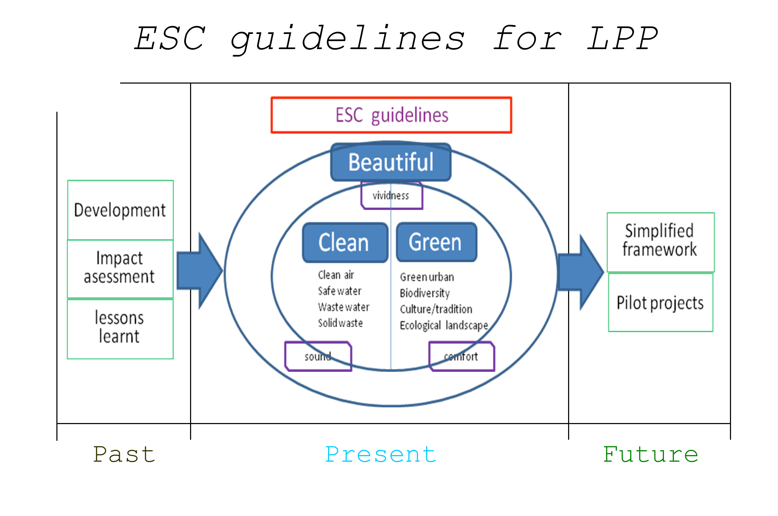
Lao Pilot Program - Environmental Management Component
(LPPE)
Supported by JICA
Project’s Proprietor: Department of Pollution Control, MONRE
Pilot Project Areas:
  Vientiane Capital, Luang Prabang, Xayyabouly
Duration: 2012-2015
Objective: To build ESC Model Cities
Key Activities: 3Rs (Reduce, Reuse, Recycle)
Outcome: ESC Guideline for further ESC Implementation Projects throughout the country focusing on:
  Vision
  Strategy
  Implementation based on PDCA (Plan, Do, Check, Action)

Slide 21
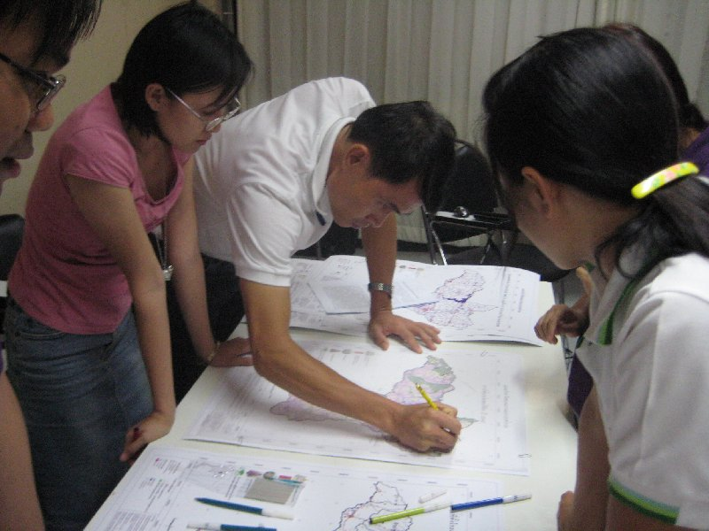
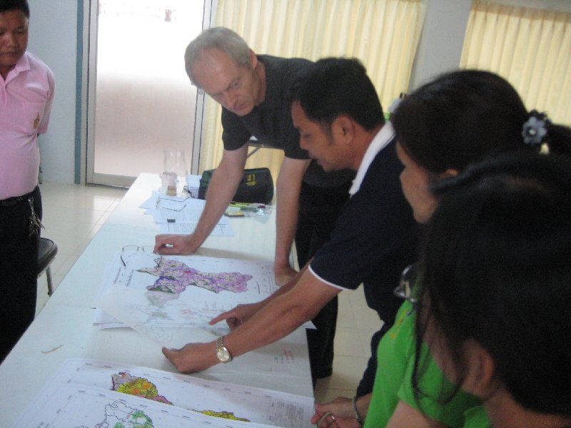
Started the Integrated Spatial Planning (ISP) Program
- 2007 to 2010 under supports of SEM2 & EMSP.
- Now, it is supported by LENS II
ISP is about planning for sustainable utilization of our surroundings or space and involves;
ISP helps establish a framework for land use, protection and enhancement of nature & environment, location of future residential & industrial areas, and location & type of large investment projects.
ISP has special potential to integrate 3 interdependent dimensions of sustainable development: “Economic, Social, & Environmental”.

Slide 22

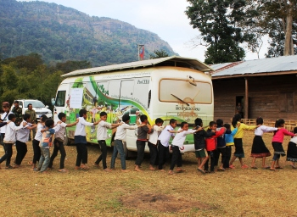
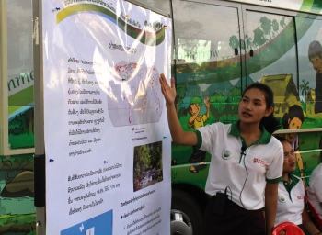
Environmental Education and Awareness Raising
- Promotion of Climate-related Environmental Education (ProCeed)
Duration:
  Phase I: 2012-2015
  Phase II: 2015-2017
Target Areas/groups:
  Governmental Officials (e.g. policy-maker…)
  Schools and villages in 3 Provinces
  (Houaphan, Khammouan, Xayabouly)
Key Activities:
  Awareness Raising of Environment & Climate Change in Schools & Villages
  Awareness Raising on Social Media (Radio, TV program, website…)
  Publications

Slide 23
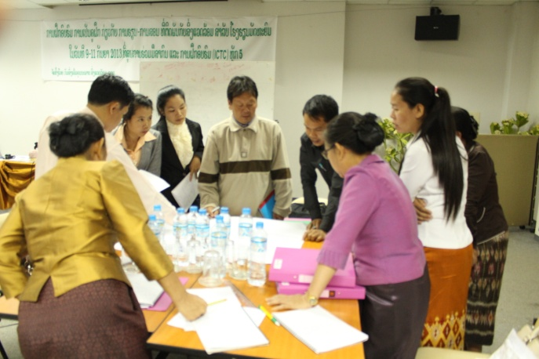
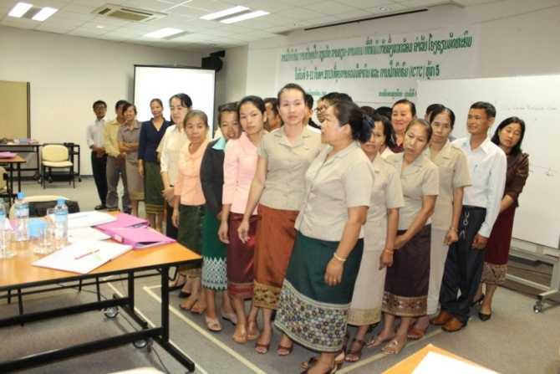
Environmental Education and Awareness Raising
- Environmental Education and Climate Change Curriculum
Sponsor: Hanns Seidel Foundation
Duration: 2013-2015
Target Areas: Kindergarten to High school
Key Activities:
  Environmental and Climate Change Curriculum Development
  Teacher Training
  Publication of Teaching and Learning Textbook of Environment and Climate Change

Slide 24
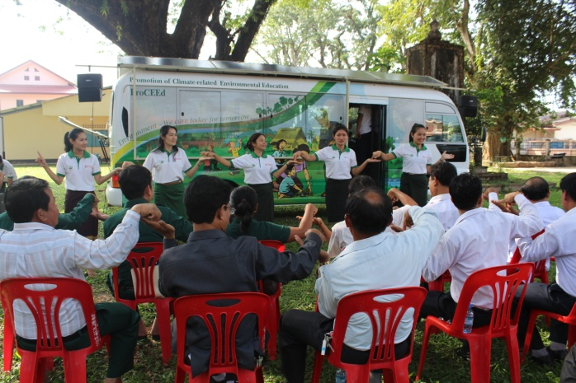
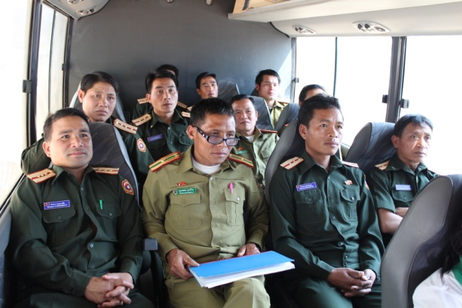
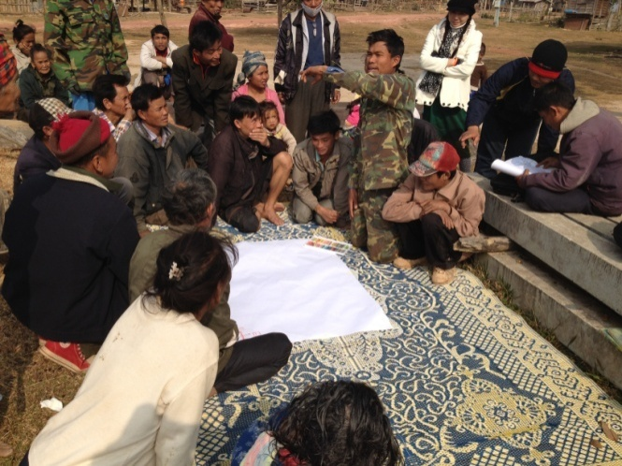
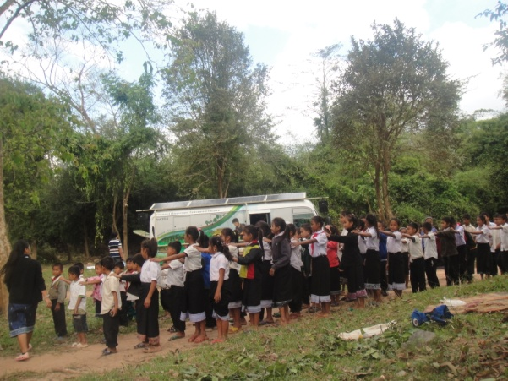
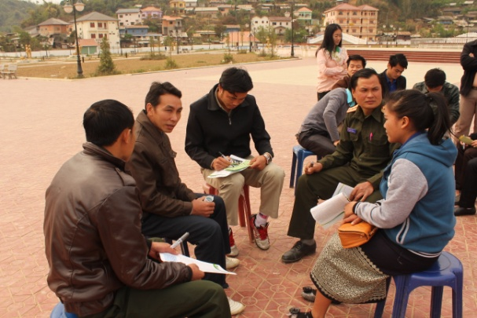
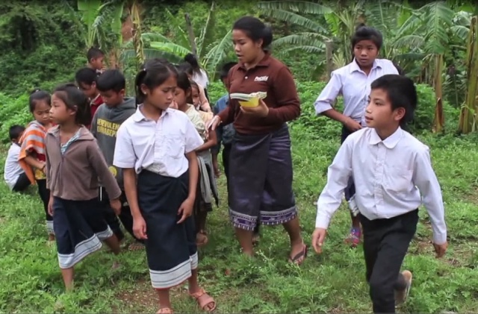
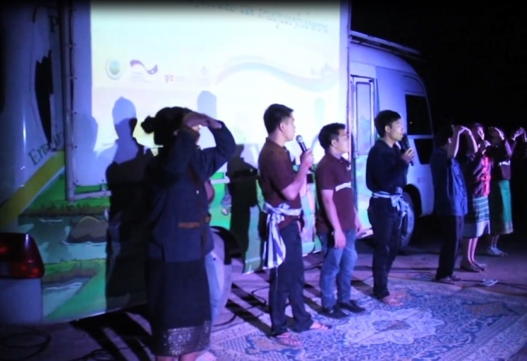
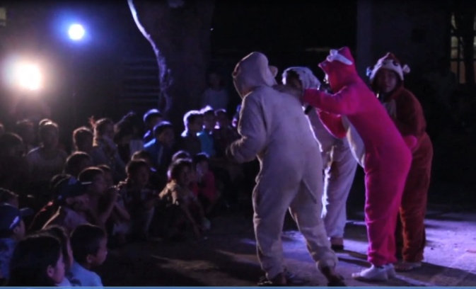
Public Awareness Raising of Environment & Climate Change

Slide 25
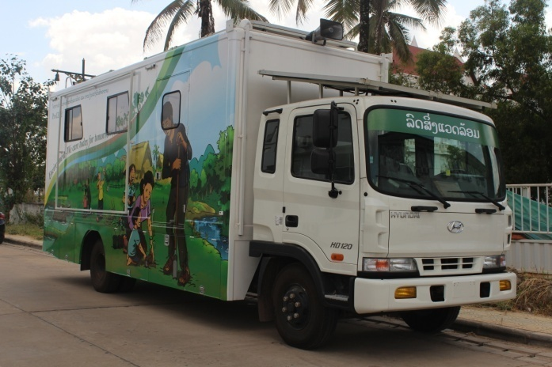
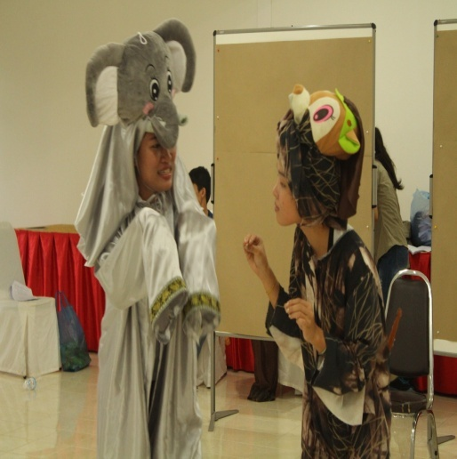
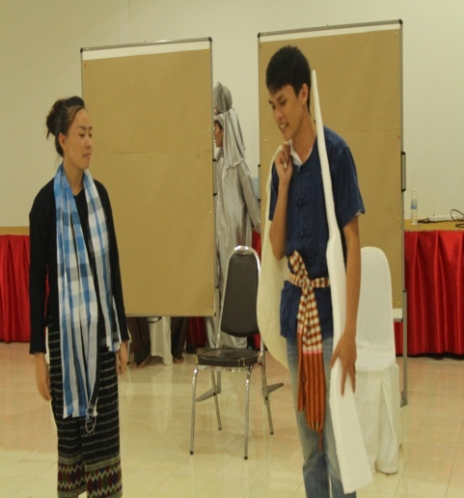
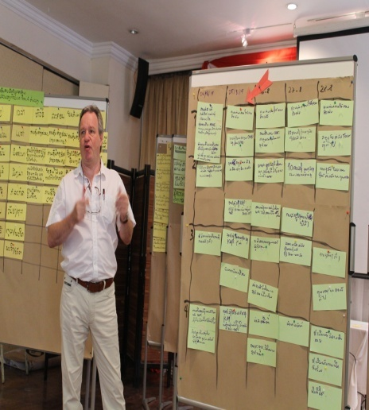
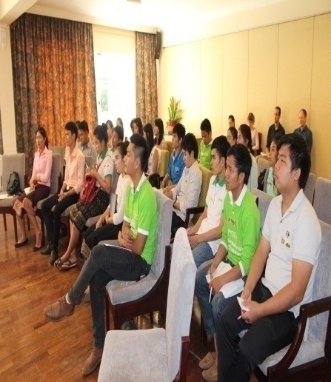
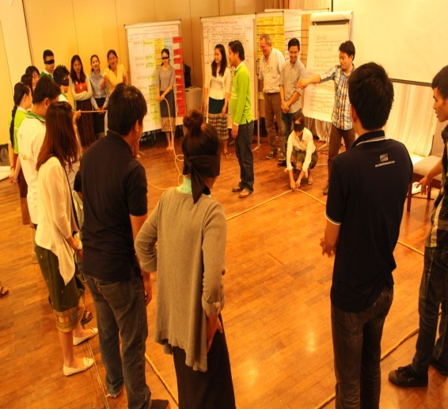
Awareness Raising

Slide 26
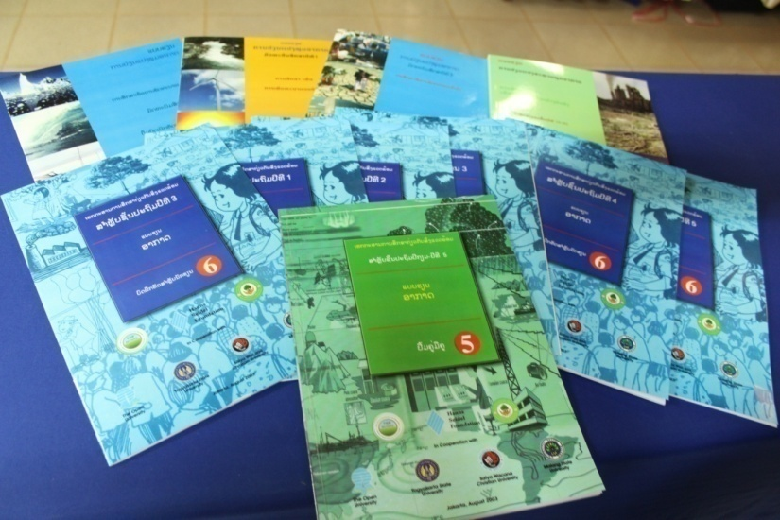
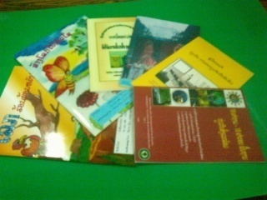
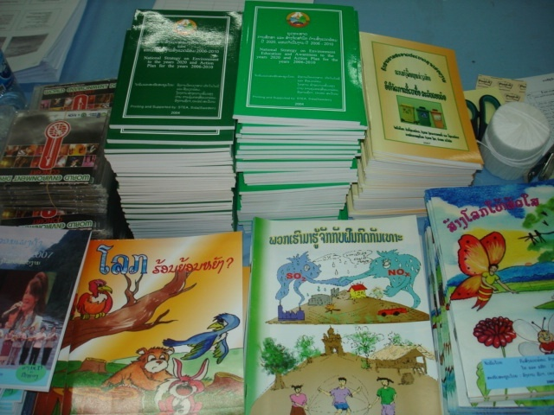
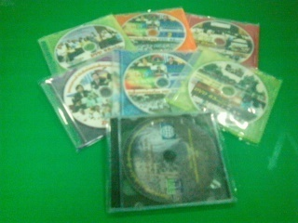
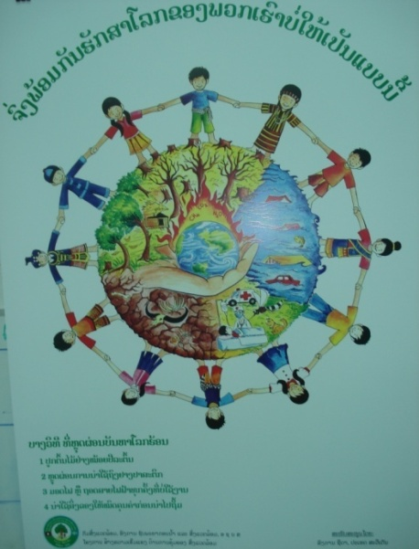
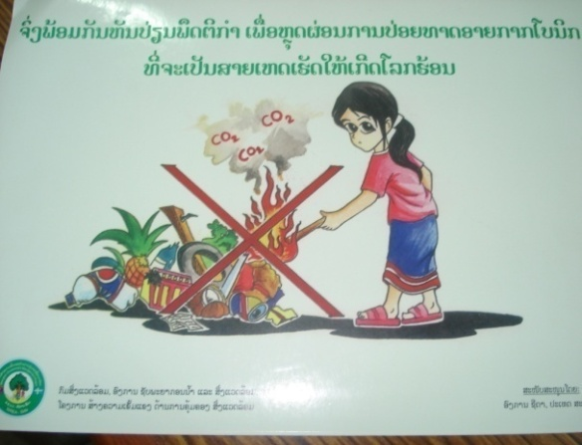


Publications
Âì¡¡¿ìñ¤»Éº­¢›­©É¸¨­Õ´õ¢º¤´¸­´½­÷©
¥‰¤²Éº´¡ñ­¹ñ­¯È¼­²ô©ªò¡¿À²ˆºÍÐ©°Èº­¡¾­¯Èº¨ê¾©º¾¨¡¾¡Â®­ò¡
¡ö´¦…¤Á¸©ìÉº´
ºö¤¡¾­ §ñ®²½¨¾¡º­­Õ Áì½ ¦…¤Á¸©ìÉº´
¦½Îñ®¦½Îø­Â©¨: ºö¤¡¾­ §ó©¾, ¯½Àê© ¦½¸óÀ©ñ­

Slide 27
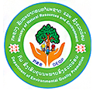


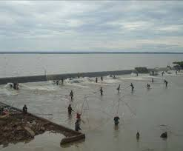
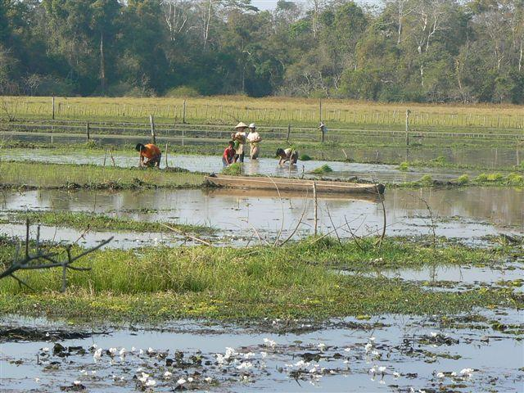
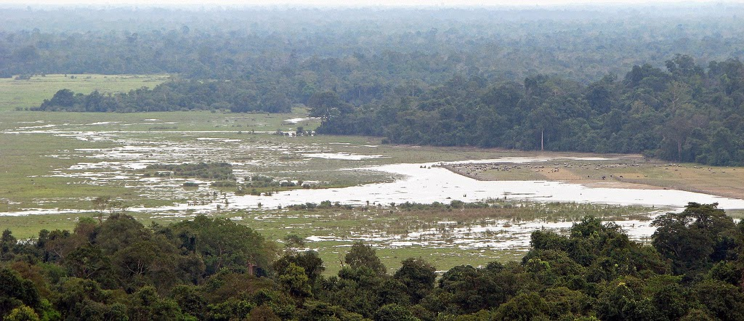
Climate Change Adaptation in Wetland Areas (CCAW) Project
- Priority Areas: 1. Xe Champone wetlands in Savannakhet Province (Central Part)
2. Beung Kiat Ngong wetland in Champasack (Southern Part)
- Strategic framework: Enhanced capacity of government and communities to adapt to and mitigate climate change and reduce natural disaster vulnerabilities related to agriculture, forestry and fishery
This Project is funded by Global Environment Facility (GEF) under the Ramsar Convention on Wetlands, adopted in the Iranian city of Ramsar in 1971 and came into force in 1975.

Slide 28
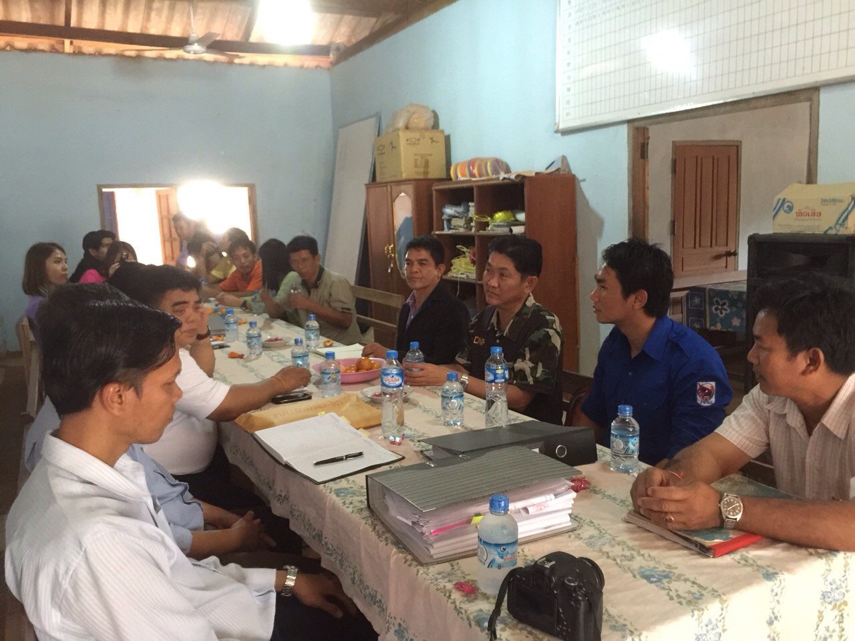
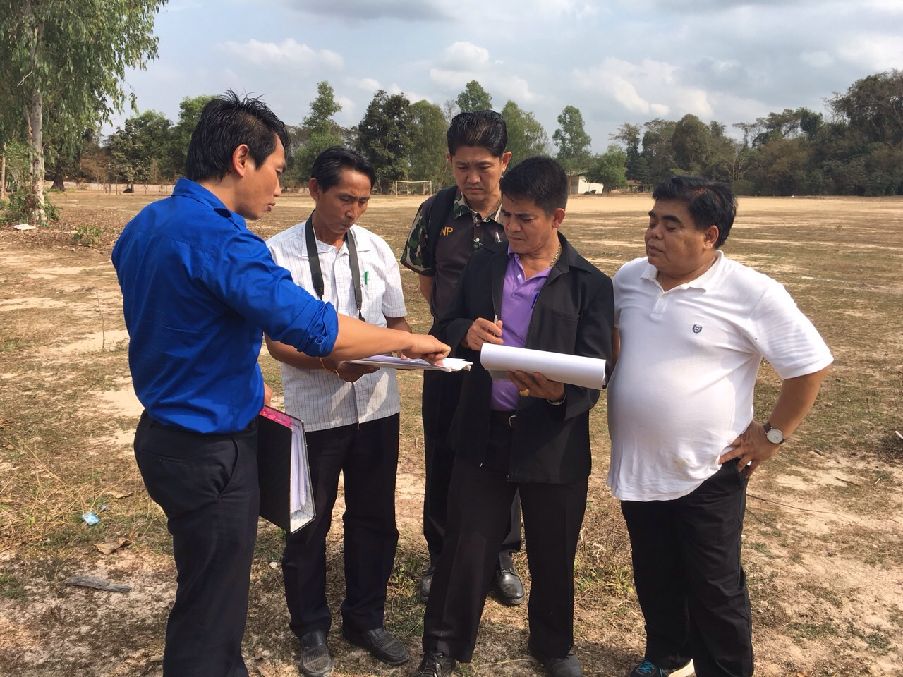
“Arboretum” Establishment Project for Biodiversity Conservation and Study Program
on a Total Area of 5 ha
Under the Cooperation between Government of Laos & Royal Government of Thailand

Slide 29
SCP Initiative in the Lao PDR
On 9-10 Nov 2017, MONRE opened the National Roundtable Meeting to discuss about how to mainstream the SDG 12 – Sustainable Consumption and Production into the Socio-economic Development Plan following the Mid-term review of the 8th National Socio-economic Development Plan in 2018.

Slide 30

Main Challenges for Natural Resource Management and Environmental Protection
Within MONRE
  Budget or financial resources are still not fully secured for its 5 year programmes and activities;
  As a young organization, Capacity Building is highly demanded;
  Inadequate of tools and equipment to perform its mandate.
General aspects
  Existing poverty and least education in some local communities might probably lead to carelessness & inattention to natural conservation and environmental protection;
  Practicing conventional agriculture, industrial production activities, and improper waste management practices are now challenging both underground & surface water quality monitoring & management;
  More coordination and synchronization among government agencies and local authorities is still required to fully support our Natural Resources and Environment Program such as a full recognition of ISP;
  Limitation of high qualified local experts and advanced technology in environmental management & monitoring.

Slide 31
4. Conclusion
  National resource management and environmental protection is still facing with many challenges,
  such as:
    limitation of budgets, qualified experts, and poverty leading to carelessness & inattention to natural conservation and environmental protection;
Towards sustainable development and good practice, it requires a great attention by government and all its citizens to become one and take action together. In case of Lao PDR, MONRE is a core agency to guide, assist, and monitor for this outcome;
MONRE uses its existing legal framework, as well as it vision toward 2030, Strategy 2025 and its five-year plan 2016-2020 as a basis for its mandate implementation to achieve the goal of “Green, Clean & Beautiful Laos and SDGs by 2030”;
Cooperation & assistances among Laos, regional & international development partners remain critical.

Slide 32
5. Recommendations
  As a young organization, more coordination & synchronization among government agencies & local authorities, private sectors, & international partners is still required to fully support our Natural Resources & Environment Programs, in particular:
    capacity building (e.g. environmental quality promotion and protection…),
    public awareness raising (e.g. climate change, SCP,…),
    environmental policy and planning,
    promoting a full recognition of ISP among local authorities,
    technology transfer (e.g. environmental pollution monitoring system… );
    joint research study on effective and efficient management of natural resource and environmental policy and planning.
    strengthened cooperation among relevant public, private, and international agencies.

Slide 33
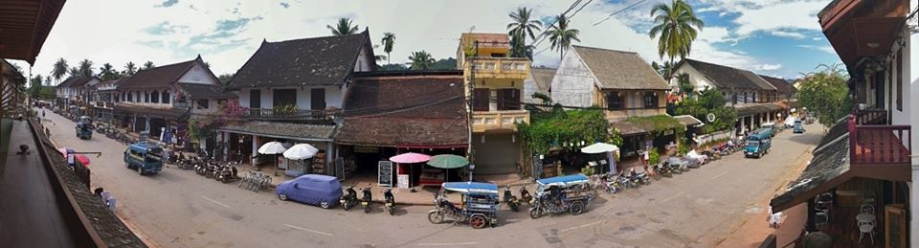
Thank you very much for your attention!
“Environmental issues are not only one person’s concerns, but the shared responsibilities of
the entire collective body involved.”

Slide 34


Any question, please?

