Slide 1
Launching Ceremony of Laucang-Mekong Environmental Cooperation Center and Supporting Meetings
15, Nov 2017
Beijing,China
Myanmar’s Initiatives ofEnvironmental Mainstreaming into Development towards SDGs
Ms. Zin Mar Tun and Ms.Nyein Nyein Khine
Ministry of Natural Resources and Environmental Conservation
15-11-2017

Slide 2
Outlines
Country Profile
Environmental Policy Guidance
Coordinating Institution
Environmental Mainstreaming
SDGs Indicators Availability
Future Steps

Slide 3


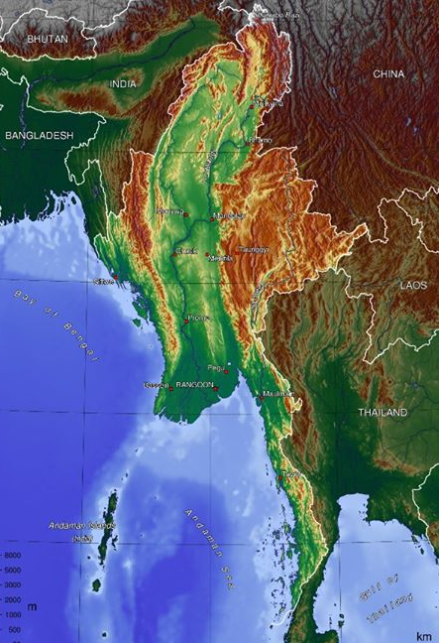
Introduction
Official Name: The Republic of the Union of Myanmar
Location: 22‘ 00‘ N, 98’ 00‘ E
Capital: Yangon
Administration City: Nay Pyi Taw
Area: 676,578 sq. km
International Boundary: 5860 km
Races: 135
States & Division: 14
Neighbouring Countries: China, Laos, Thailand, Bangladesh, India
Seacoast: Bay of Bengal, Upper Corner of Andaman Sea

Slide 4
Political Guidance
Environmental Mainstreaming
By NLD’s Chairperson Daw Aung San Suu Kyi 2015 Election Manifesto, stating “…Where there is natural resource extraction and usage, we will lay down appropriate methods so as to avoid environmental and ecological damage”
“…We will enact legislation to assess and evaluate the risks of environmental harm resulting from domestic and international investment.”
By Former President U Thein Sein’s inaugural address to Pyidaungsu Hluttaw (Union Parliament, 30 March 2012), stating “…we will lay down a new policy in which we will work for economic development in parallel with environmental conservation” .

Slide 5
State Constitutional policy guidance
Political guidance: Environmental sustainability as a key prerequisite for sustainable economic development.
National Constitution (2008): “The Union shall protect and conserve natural environment” “Every citizen has the duty to assist the Union in carrying out the environment conservation”
Ministry’s Vision
To conserve and protect natural resources of the country
To extract and utilize the country’s natural resources in a sustainable manner so that they can be inherited and transferred from one generation to another
To create harmony of environmental conservation and implementation of development projects in a balanced manner

Slide 6
Environmental Policy 1994
To harmony and balance between these through the integration of environmental considerations into the development process to enhance the quality of the life of all its citizens.
It is the responsibility of the State and every citizen to preserve its natural resources in the interest of present and future generation.
Environmental protection should always be the primary objective in seeking development."

Slide 7
Enabling State Constitutional policy guidance
Political guidance: Environmental sustainability as a key prerequisite for sustainable economic development.
National Constitution (2008): “The Union shall protect and conserve natural environment” “Every citizen has the duty to assist the Union in carrying out the environment conservation”

Slide 8
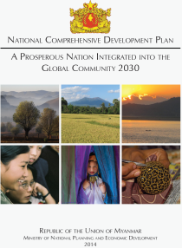
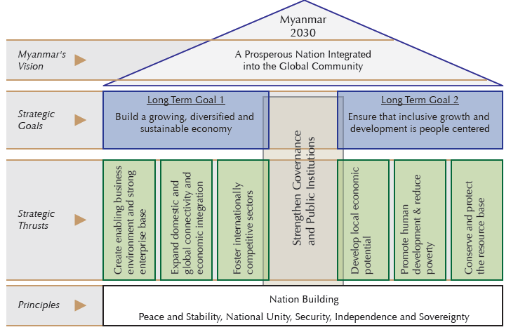
Mainstreaming: National Framework Guidance (NCDP-2015)

Slide 9
Key strategic principles for the Environmental Safeguards (NCDP 2015)
Managing the environment and natural resources, such as land, forests, water and coastal ecosystems in a sustainable manner,
Promoting sustainable and transparent investments in oil and gas production, mineral extraction, hydro-power, infrastructure and agriculture in ways that sustain the resource base and benefit the local and national population as a whole;
Reducing environmental health risks from air and water pollution with improved access to energy, water and sanitation;
Reducing vulnerability to climate change related disasters and impacts

Slide 10
Enabling conditions
State Constitution (2008)
Environmental Policy (1994)
Myanmar Agenda 21 (1997)
National Sustainable Development Strategy –NSDS (2009)
Environmental Conservation Law (2012)
Environmental Conservation Rule (2014)
Environmental Impact Assessment Procedure (2015)
National Environmental Quality (Emission) Guideline (2105)

Slide 11
Environmental Objectives (Environmental Conservation Law – 2012)
to implement the Myanmar National Environmental Policy;
to lay down the basic principles and give guidance for systematic integration of the matters of environmental conservation in the sustainable development process;
to emerge a healthy and clean environment and to conserve natural and cultural heritage for the benefit of present and future generations;
to reclaim ecosystems which are starting to degenerate and disappear;

Slide 12
Environmental Objectives (Environmental Conservation Law – 2012)
to manage and implement for decrease and loss of natural resources and for enabling the sustainable use beneficially;
to implement for promoting public awareness and cooperation in educational programmes;
to promote international, regional and bilateral cooperation;
to cooperate with Government departments, organizations,INGO, NGO and individuals.

Slide 13
Partnerships and cooperation
Integrated Approach: Multi-stakeholders Engagement
NGOs, CBOs,
Private
Community
Academies, Researchers
MOECAF & Cross Ministries
Parliaments
UN Agencies, Int. Orgs
Resilience, low carbon and inclusive Growth
Environmental Sustainability
Sustainable Development Goals- SDGs

Slide 14
Multi-stakeholders partnerships for Environmental Safeguards
MONREC
Environmental Conservation Dept.
NECCC
State & Region EC
6 Technical WGs
- Policy
- Climate change
- Landuse &NR
- Urban & Industry
- Green Economy
- Env. Education
District
Township level EC
Relevant Depts. and Ministries
CSO, NGO, Private Sectors
UN agencies, DPs and INGOs

Slide 15
Environmental Mainstreaming into Development
Water use and quality
Tools
Wastes
EIA/IEE/EMP
Development
Resources based and Industry based
Hazardous materials
?
Land use and biodiversity
National Environmental Quality Guidelines
Air quality
Noise and Vibration
Energy Use
Sustainable Development
Visual Impacts
Social & culture

Slide 16
Enabling policy framework guidance
Environmental sustainability is recognized in the National Constitution and in the National Comprehensive Development Planning as a key prerequisite for sustainable economic development.
Given the current stage of the country's political and policy development, a comprehensive environmental related strategic framework are needed to devlope to integrate environment into National/State& Region/Sector Development Policy and Development Planning.

Slide 17
Integrated approach towards SDGs through mainstreaming Environmental Policy instruments
National Environmental Policy and Strategic framework & Master Plan
National Waste Management Strategic Policy Framework
National Climate Change Policy & Strategy
National GE Policy Strategic Framework
Action Plan for National Climate Change Adaptation and Mitigation
Green Economy Green Growth Action Plan
Waste Management Action Plan
Forest
Biodiversity
water
EnviroQuality
Land
Marine
Agric
Indu,& Trans
Health
Tourism
Culture
Extractive Industries
Urban/Infrastructure
Energy

Slide 18
Environment and the SDGs
National Environmental Policy
SDGs
National Waste Management Strategy and Action Plan
National climate change strategy and Action Plan
Green Economy Policy Framework

Slide 19
Overview: Myanmar Environmental Policy
Framework-
Key sectors
Agriculture
Transport
Mining
Electricity
Industries
Health
Forestry
Fisheries
Energy
Cross sectors
Climate change
Human settlement
Env treaty
Waste
Biodiversity
Marine & Coastal resources
SEZ
Water resources
Landuse

Slide 20
The National Environmental Policy: a foundation of framework for environmental mainstreaming for decision-making integrated economic and social development and pathway to sustainable development:
Identifying a long term vision for environmental protection and sustainable development in Myanmar, supported by key national environmental policy principles providing a framework for establishing detailed, strategic policy frameworks and action plans setting a basis for enhancing environmental governance in Myanmar.

Slide 21
National Environmental Policy Principles & SDGs
Clean environment and healthy, functioning ecosystems
1. Every person and citizen living in the Union of Myanmar has the right to access to a clean and healthy environment, and to protect the environment. (Goal 1,2,3, 6)
2.The complete value of Myanmar’s environment is recognised and considered– both tangible and intangible values, including its significant spiritual values, ecological assets and cultural heritage, in addition to its direct benefits for humanity.
3. Environment and natural resources management will recognise the critical roles that Myanmar’s natural capital and ecosystem services play in the country’s society and economy. (14,15)
4. Myanmar’s ecosystems are to be protected and managed in sustainable ways to ensure their natural functions and resilience, and rich biodiversity, are maintained. (Goal 13,14,15)
5. Myanmar’s natural resources are to be protected and managed in integrated and sustainable ways to ensure their availability and quality for future generations is not diminished. (Goal 14, 15)

Slide 22
National Environmental Policy Principles & SDGs
6. The rights of indigenous people and ethnic nationalities to their lands, territories, resources and cultural heritage, and their contributions to the respect for and conservation of the environment and natural resources, is recognised and protected. (Goal 10, 16)
7. Environmental service provisioning (including solid waste management, wastewater treatment, drinking water purification, ambient air and water quality monitoring and management) will be included as necessary parts of infrastructure planning and development for urban and human settlement areas, with resource efficient and zero waste approaches used. (Goal 6, 7,9,11,13,14,15)

Slide 23
National Environmental Policy Principles & SDGs
Sustainable economic and social development
8. Environmental sustainability will always be the primary objective in determining Myanmar’s economic and social development strategies, which will prioritise low-carbon and green economy pathways. (Goal 1, 8, 10)
9. Recognising the inextricable link between environment and poverty, environmental considerations are central to effective people-centred development and will guide development strategies so that sustainable, green, and equitable approaches to improved prosperity and living standards are pursued. (Goal 12)
10.Sustainable and renewable energy for the needs of people and for economic development in Myanmar will be achieved through the use of existing technology and innovations in the generation, storage, supply and use of energy. (Goal 7, 9, 11, 14, 15)
11.Climate smart approaches to development, including resilience, natural disaster risk management and climate change adaptation and mitigation strategies, will be aligned to environmental protection and natural resource management approaches in the pursuit of low-carbon, sustainable development. (Goal 7, 9, 11, 13)

Slide 24
National Environmental Policy Principles & SDGs
12.Economic values of environmental services will be recognised and incorporated in development policies so that these values are optimised and captured to the extent possible. (Goal 15)
13. Pollution and waste is to be avoided and minimised at the source as more cost effective than remediation, with enterprises encouraged to adopt clean production principles and industrial best practices that go beyond regulatory requirements. (Goal 3, 6)
14.Remediation of past environmental damage will be prioritised in development planning and decision-making to promote green outcomes and give effect to the polluter pays principle. (Goal 8)

Slide 25
National Environmental Policy Principles & SDGs
Mainstreaming environmental protection and management
15. Institutional and legal frameworks for implementing and enforcing environmental laws and policies will be strengthened through clear definition of rights and responsibilities, and greater collaboration among different institutions within the government at all levels, as well as with non-government stakeholders. (Goal 16,17)
16. All decisions on activities, projects, policies and plans that could have environmental impacts will be subject to prior comprehensive assessment of their potential impacts, applying the precautionary principle, systematic risk assessment and the mitigation hierarchy. (Goal 16)
17. Environmental decision making at all levels will be inclusive, transparent and accountable to relevant stakeholders, with communities and citizens having the right to participate in decisions and access information that could affect their lives and property. (Goal 16)
18. Gender equality and the empowerment of women and girls will be integrated in all aspects of environmental protection and management. (Goal 5)

Slide 26
National Environmental Policy Principles & SDGs
19. Environmental education, public awareness raising and quality research will be promoted to enhance respect for the country’s environmental values, understandings of environmental challenges and commitments to environmental conservation and sustainable development. (Goal 4)
20. Environmental governance arrangements will be responsive to peace processes, and arrangements in self-administered areas, recognising that peaceful and just societies, and environmental conservation and sustainable development efforts are mutually beneficial. (Goal 16)
21. Financial sustainability of environmental governance will be achieved, including through the application of the polluter pays principle and the use of green financial instruments.
22. International cooperation will be sought to strengthen environmental conservation and sustainable development in Myanmar, and provided for efforts to address regional and global challenges, including through bilateral and multilateral agreements, experience sharing and implementation arrangements. (Goal 17)
23. National environmental interest will be given thorough consideration before signing international treaties, with international investment treaties to recognise Myanmar’s evolving environmental governance, and ratified international agreements to be honoured in the most environmentally sustainable manner.

Slide 27
National Climate Change Strategy and Action Plan-
NCCSAP
GOAL
By 2030, Myanmar is achieving climate resilience and is engaged in low-carbon, resource efficient & inclusive development as a contribution to sustainable development
STRATEGIC OBJECTIVES
Increase adaptive capacity and resilience of communities and sectors
Maximise opportunities for low carbon development in potential sectors
FOCUS AREAS (KEY ENTRY POINTS)
Agriculture and Food Security
Environment, and Natural Resources
Energy, Transport, and Industry
Urban, Building and Human Settlements
Education, Awareness, Science and Technology
DRR, Health
and Early Warning Systems
STRATEGIC PRIORITIES (FOR EACH FOCUS AREAS)
Integrating Climate Change
Policy, Legislation, Planning, Budgeting
Institutional Arrangements Coordination Mechanisms,
Human Skills, Implementation,
Monitoring and evaluation
Financial Mechanisms
Fund management,
Financial instruments
Access to technology
Access to environmentally sound technology for adaptation and mitigation
Awareness, and Capacity Capacity, Education and awareness, Research data & innovation
Muliti-stakeholder Partnerships
Public, (including CSOs) private partnership; Joint implementation; International cooperation

Slide 28
Myanmar Climate Change Strategy and Action Plan 2016-2030 and contributions to SDGs
MCCSAP 2016-2030
3. Good health
12. Responsible consumption
13. Protect the planet
14. Life below water
15. Life on land
1. No poverty
2. No hunger
7. Renewable energy
6. Clean water and sanitation
11. Sustainable cities and communities
MCCSAP Sectoral Outcomes:
1. Smart Agriculture, Livestock and Fishery for Food Security
2. Healthy Eco-systems
5. Healthy Climate Resilient Society
6. Smart Society (education and techno)
3.Sustainable Energy, Transport and Industry
4. Resilient Cities and Towns
Notes:
MCCSAP has 6 sectoral outcomes
5 of them (1 to 5) contribute quite directly to a number of SDG.
Arrows are not good design but they show what MCCSAP sectoral outcome supports what SDG

Slide 29
National& City Waste Management Strategy
and Action Plan-NWMSAP(Draft)
Vision : “Sustainable, Green, Clean and Healthy Environment towards a Brighter Future for Myanmar”
Mission: To develop and implement the holistic/ integrated waste management strategy based on principles of inclusiveness, zero waste and circular economy to achieve a greener, cleaner and healthier environment.
Objectives of the NWMSAP:
Goal A: Promote waste minimisation, reuse, recycling and recovery to establish a resource circular society
Goal B: Ensure the effective and efficient delivery of waste services
Goal C: Ensure sustainable budgeting and sound financial management of the waste sector
Goal D: Compliance, monitoring, enforcement and recognition
Goal E: Capacity development, awareness raising and advocacy

Slide 30
National Waste Management Strategy and Action Plan and its contributions to the SDGs
Waste management is an integral part of the SDGs Agenda 2030
Waste management has strong linkages to a range of other global challenges: e.g.
climate change
poverty reduction
food and resource security
sustainable consumption
and production.
Ensure sustainable budgeting and sound financial management of the waste sector
NVMSAP
3. Good health
6. Clean water and sanitation
11. Sustainable cities and communities
12. Responsible consumption
13. Combat Climate change
14. Life below water
15. Life on land
Compliance, monitoring, enforcement and recognition
Promote waste minimisation, reuse, recycling and recovery
Capacity development, awareness raising and advocacy
Ensure the effective and efficient delivery of waste services

Slide 31
Overview: Green Economy Policy Framework- GEPF (Draft)
Focused on the opportunities and challenges related to investments
GEPF aligned with SDGs
Will support monitoring of progress towards the SDGs
Leverage and support implementation of the NCDP, climate change strategy, INDC and other strategies and policies
Stimulate green investments from the private sector
Manage impacts from brown investments
Ensuring sustainable financing for the public sector
Fostering human capital – within government and creating jobs
Guiding principles: sustainable, inclusive and efficient
Natural resource-based sectors
Agriculture and livestock
Fisheries
Water
Forests
Extractive industry
Renewable energy
Efficiency-based sectors
Non-renewable energy
Manufacturing
Buildings
Transport
Waste
Urban and human settlements

Slide 32
Green Economy Policy Framework and its contributions to the SDGs
GEPF
3. Good health
Goal 6. Clean water and sanitation
11. Sustainable cities and communities
12. Responsible consumption
13. Protect the planet
14. Life below water
15. Life on land
1. No poverty
2. No hunger
7. Renewable energy
Manage impacts from brown investments
Stimulate green investments from the private sector
Ensuring sustainable financing for the public sector
Fostering human capital – within government and creating jobs
Notes:
How GEPF contributes to the SDGs

Slide 33
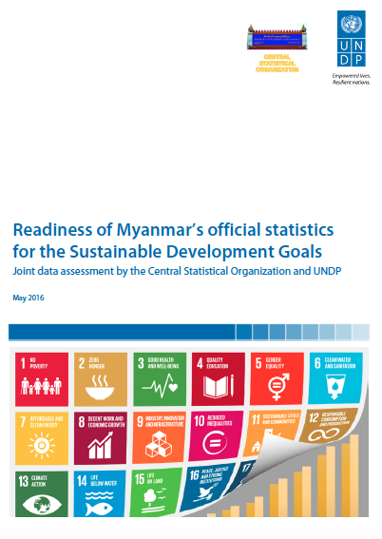
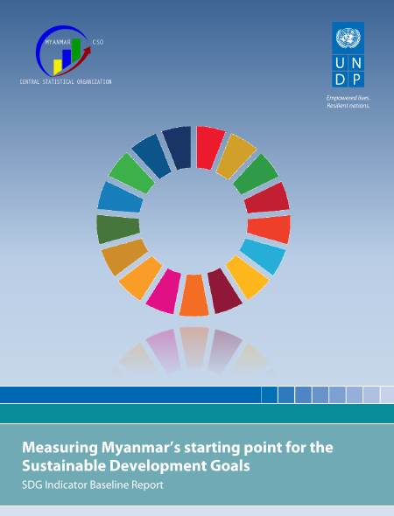
SDGs Indicators Availability
Among SDG Indicators including split indicators, 61% is available for Myanmar (36% from National ad 65% from International sources )
Least available indicators are form Goal 13 (30%) and 14 (37.5%)
Most available indicators are from Goal 8 (85%)
Currently unavailable indicators form national sources are from Goal 6, 12 and 14 and most of them are from Environment Sector.
Data
Assessment
Report
 | No | %
Official SDG Indicator | 241 | 100 %
Indicators after splitting | 321
Indicators described in Baseline Report | 196 | 61%
Indicators by National Sources | 71 | 36%
Indicators by International Sources | 125 | 65%
Rephrased Indicator | 22 | 11%
196 Indicators presented in this Baseline report
In total 320
“split” indicators
61% of SDG Indicators available

Slide 34
Future Step(2016—2020)
Ensuring Environmental Sustainability toward Sustainable Development Goals
Institutional & HDR
Strategic Env Policy Framewok, legislation and Plan
Integrated Monitoring System
Climate Change Adaptation& Mitigation
Financial Mechanism
R& D Education and extension
EIA implementation
International cooperation and PPP

Slide 35
Gaps
Specific Rules, Regulation and Guidelines
Coordination Mechanism and Institution
Public Private Partnership
Financial Mechanism
Environmental sound Development Policy and Strategies Framework
Clean and green Technology
International Cooperation
Research &Development Innovation

Slide 36
Thank you for your attention

