Slide 1
National Environmental Policies of Thailand and the implementation of SDGs
Launching Ceremony of Lancang-Mekong Environmental Cooperation Center
and Supporting Meetings
15-17 November 2017
International Environmental Convention Implementation Building, Beijing, China
By PRASERT SIRINAPAPORN,
Director, Office of National Environment Board
Office of Natural Resources and Environmental Policy and Planning (ONEP)

Slide 2

issues
The National Policy in Thailand
Environmental Quality Management Plan 2017-2021
National action towards SDGs
SDGs implementation: Goal 6
Conclusion
2

Slide 3



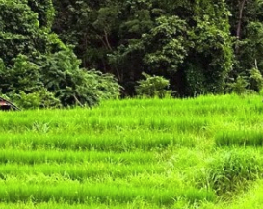

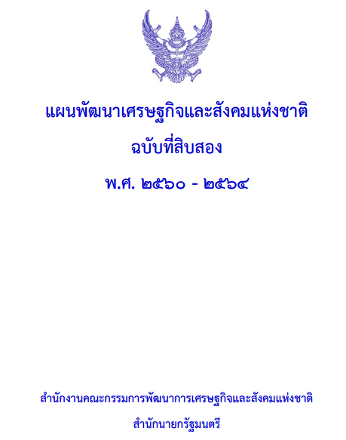

The National Policy in Thailand
v
Prosperity
Competitive-
ness
Philosophy of Sufficiency Economy
Stability
Equality
v
Human Resource
Sustainability
Stability
Government
Management
Green Growth
The National Strategy
National Economic & Social Development Plan 2017-2021
Environmental Quality Management Plan 2017-2021
3

Slide 4


Environmental Quality Management Plan 2017-2021
Strategy 1 Manage Natural Resources with Balance and Fairness
Strategy 3 Improve Efficiency to use natural resources and environment sustainably
Strategy 4 Build Capacity to Cope with Climate Change Impacts and Natural disasters as well as promote international collaboration
Strategy 2 Prevent, Treat and Rehabilitate for Better Environmental Quality
4

Slide 5






National action towards SDGs
17 Goals 169 Targets 241 Indicators
The CSD was established.
SDGs 17 Goals distributed to many responsible ministries.
MNRE takes responsibility in 5 SDGs (No. 6, 12, 13, 14 and 15).
Thailand aims to conduct the Voluntary National Report annually.
Key: 5 Goals 43 Targets 52 Indicators
Support: 5 Goals 8 Targets 10 Indicators
(Goals 2, 8, 9, 11, 17)
5

Slide 6
The National Committee for SD
Chaired by the Prime Minister
Sub-committee
Implement SDGs
Chaired by Minister of Prime Minister Office
Promote understanding & evaluate SDGs through SEP
Chaired by the expert of civil society
Develop MIS for SD
Chaired by the expert of Private Sector
SEA
Chaired by the environmental expert
Working Group
Integrate SDGs for Implementation
Conduct the National SDGs reports
Develop Economic-Social-Law mechanism to support SD
6

Slide 7





MNRE and 5 SDGs
The MNRE Committee to Implement SDGs
Chaired by the MNRE Permanent Secretary
Working Group Implementation SDGs 6
Working Group Implementation SDGs 12
Working Group Implementation SDGs 13
Working Group Implementation SDGs 14
Working Group Implementation SDGs 15
7

Slide 8

National action towards SDGs
Conduct 17 SDGs Roadmaps
The Roadmaps were approved by the CSD
The roadmaps have been Implemented in
Central organisations
CSOs
NGOs
Lecturer/researchers
People
Local Authorities
CSOs
NGOs
Local wisdom group
People
Central
Local
8

Slide 9




National action towards SDGs
Monitor & Evaluate
Report
Programs are
implemented
CSD
Comments for new policies
Voluntary National Report
9

Slide 10







SDGs implementation: Goal 6
Goal 6 Ensure availability and sustainable management of water and sanitation for all
equitable access to safe and affordable drinking water for all
Dev. Pipe water system
Conduct Water supply standard
at local level
adequate and equitable sanitation and hygiene for all
Sanitation and hygiene 99.9%
reducing pollution, eliminating dumping and minimizing release of hazardous chemicals
Local Authorities collect and treat solid waste 54% sanitarily
ensure sustainable withdrawals and supply of freshwater to address water scarcity
Build water reservoir, underground water pump station and zoning agricultural area
Conducting Water Res. Act, water res. strategy and modifying structure of water mgt. organizations
implement integrated water resources management at all levels
protect and restore water-related ecosystems
Launched Forest Res. Master Plan & aimed 40% Forest/country area
10

Slide 11
Conclusion
Influential issues from international and national levels were adopted in the national environmental policy.
SDGs have been implemented in the central area before extending to local area.
11

Slide 12





Thank you for your attention
Office of National Environment Board,
Office of Natural Resources and Environmental
Policy and Planning
60/1 Piboonwattana 7, RAMA 6 Rd., Phyathai,
Bangkok 10400 Thailand
66 2265 6601
66 2265 6602
http://www.onep.go.th/
12

