Slide 1
MINISTRY OF NATURAL RESOURCES AND ENVIRONMENT
VIETNAM ENVIRONMENT ADMINISTRATION
NATIONAL ENVIRONMENTAL POLICES OF VIETNAM
AND THE IMPLEMENTATION OF THE 2030
SUSTAINABLE DEVELOPMENT AGENDA
Nguyen Thi Phuong Mai
Vietnam Environment Administration

Slide 2
Content
General information
Legal framework for environmental protection
The implementation of the 2030
sustainable development agenda

Slide 3
GENERAL INFORMATION

Slide 4
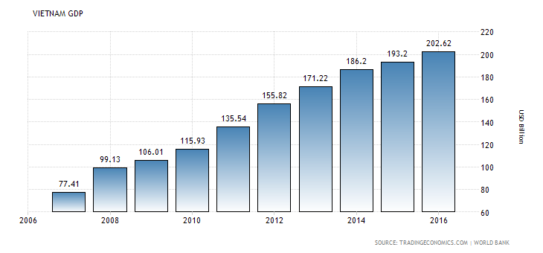
Vietnam development success

Slide 5
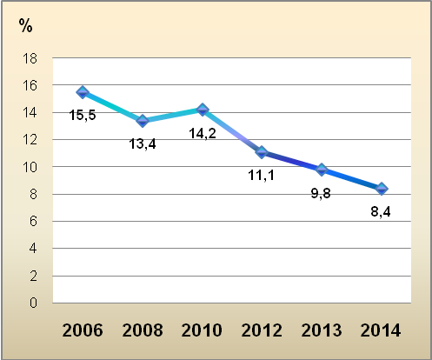
Vietnam development success (Cont.)
Rate of poor households in Vietnam

Slide 6
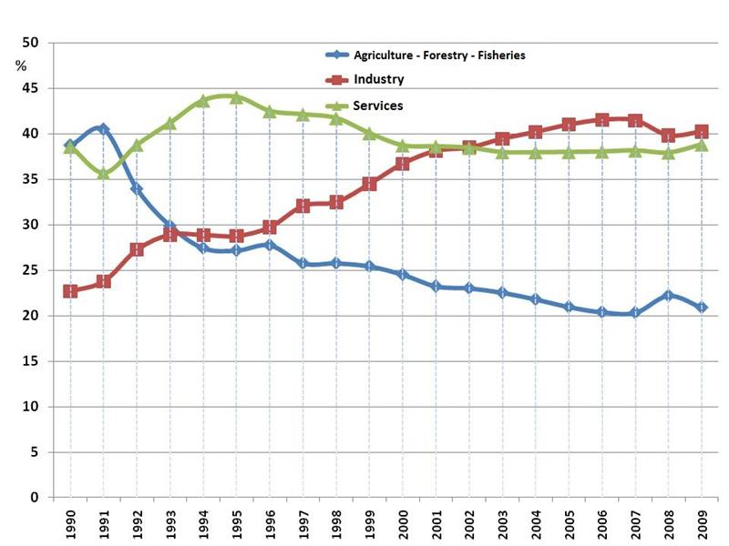
Industrialization speeds up

Slide 7
Environmental degradation is
a consequence of economic growth
1. Environmental pollution in large scale
2. Biodiversity depletion

Slide 8
Environmental pollution on large-scale
Air pollution,
Water pollution,
Solid waste pollution in urban areas, industrial zones,
tourist areas, …

Slide 9
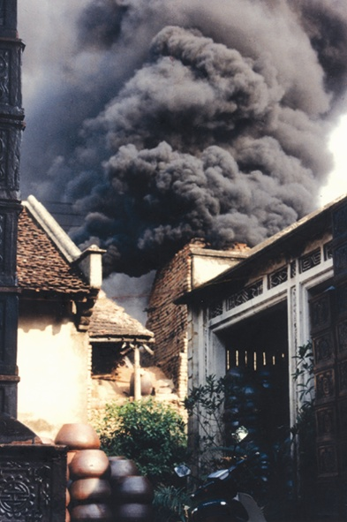
Seriously Polluting Establishments have
been identified, including industries,
hospitals, landfills, craft villages.
Cancer villages: Several villages where
the number of cancer patients are high.
Pesticides storage spots.
Dioxin storage places remained
from the war.

Slide 10
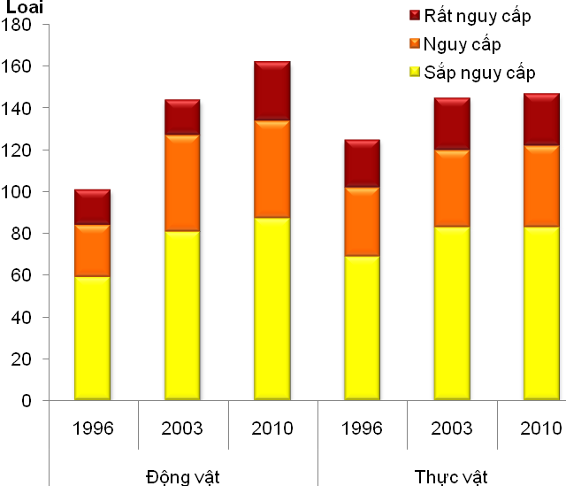
Biodiversity depletion
Vulnerable
Endangered
Critically endangered
Source: Viet Nam Environment Administration, 2012

Slide 11
LEGAL FRAMEWORK

Slide 12

System behind the Environmental Protection Law
Prevention
Reduction
Control
Recovery
Pollution Control
Conservation of Natural Value

Slide 13
System behind the Environmental Protection Law
1. Integrate environmental requirements in strategies, planning and plans of
development.
2. Request EIA of development projects
3. Control production, business, service facilities; Control importation of waste
materials
4. Waste Management; Resolving cross-border issues
5. Recover and improve the environment
6. Nature and biodiversity conservation

Slide 14
Hierarchy of political/legal system in Vietnam
Laws
Decrees
Circulars
National Assembly Prescribe basic policies | Government Specific guidelines Measures for implementation of policies | Ministries Specific guidelines as assigned by the law, by decree

Slide 15
Inter-sectoral framework
Government
MoPS
MoIT
MoNRE
MoC
MOFi
MARD
Env Police
DOSTE
VEA
DOSTE
DOSTE

Slide 16
1993
Law on Forest Protection
and Development
Law on Environmental Protection
Law on Chemicals
2005
Law on Water Resource
Law on Environmental Protection (1st revision)
Law on Fisheries
2008
Law on Environmental
Protection Tax
Law on Biodiversity
Law on Natural Resources
and Environment of
Sea and Islands
2014
Law on Environmental Protection (2nd revision)

Slide 17
Concept of the Environmental and Biodiversity Law
Environmental Law | Biodiversity Law
Protection of Environmental Elements (air, soil, water, sea, river) | Conservation of Natural Ecosystems
Environmental Protection by Areas (urban areas, residential areas, sea) | Conservation and Development of species
Waste Management | Conservation of Genetic Resources
Environmental Protection by Activities (production, trade and services)
Pollution Treatment and Environmental Recovery
SEAs, EIAs | Master Planning and Investigation,
Environmental Standards | Monitoring, Reporting and Databases
Monitoring and Reporting | Ecosystem Services
Inspection, violation handling, disputes, compensation, etc. | Inspection, violation handling, disputes, compensation, etc.
Resources for Environmental Protection | Financial Resource and International Cooperation

Slide 18
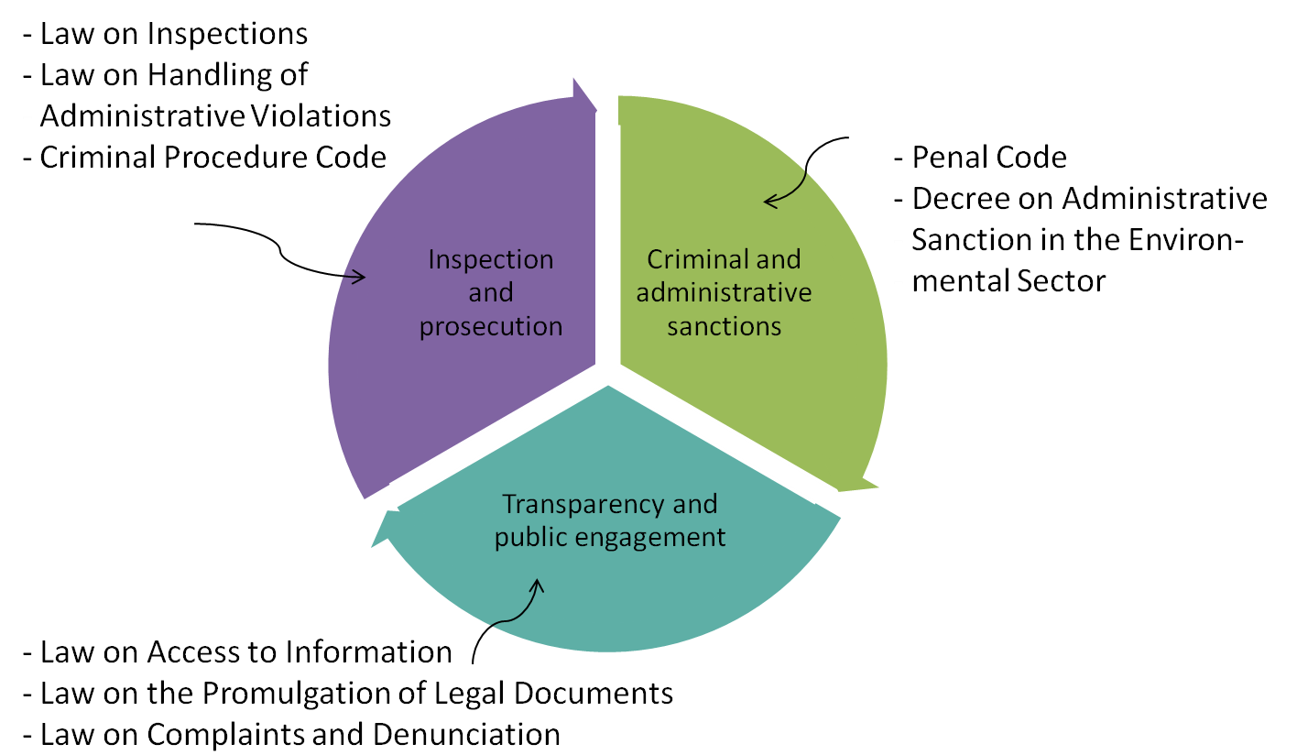
Related laws for environmental and law enforcement

Slide 19
Basic Regulation:
Law
- Environmental Protection Law (EPL) replacing the EPL 2005
- Law on conservation of biodiversity (LCB)
Decree
Detailing the implementation of some articles of the EPL, LCB.
Provisions on sanctioning administrative violations in the field of EP.
Regulations on EP planning, strategic environmental assessment, environmental
impact assessment and EP plan.
Circulars
Guidance on the rehabilitation and restoration of the environment in mining activities.
Guidance on the environmental protection of economic zones, industrial zones, export processing zones and hi-tech parks.
Circular on strategic environmental assessment, environmental impact assessment and environmental protection plan;
Etc..

Slide 20
Basic Regulation (Cont.)
Others
National strategy for environmental protection until 2020 and vision toward 2030;
Vietnamese standards of environment.
Resolutions of the Government on actively responding to climate change,
strengthening natural resources management and environmental protection.
The Prime Minister's Directive on a number of urgent tasks and solutions for environmental protection.
Etc…
Related Issues to the Environmental Law
Land Use; Architecture and Construction; Transportation; Agriculture; Fishery; Forestry; Energy (including Renewable & Nuclear Energy); Marine.

Slide 21
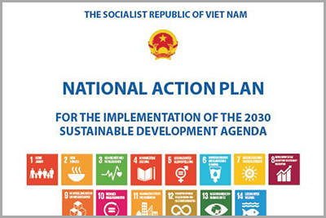
THE IMPLEMENTATION OF THE
2030 SUSTAINABLE DEVELOPMENT AGENDA
Prime Minister Decision No: 622/QĐ-TTg on 10th of May 2017 On the issuance of the National Action Plan for the Implementation of the 2030
Sustainable Development Agenda

Slide 22
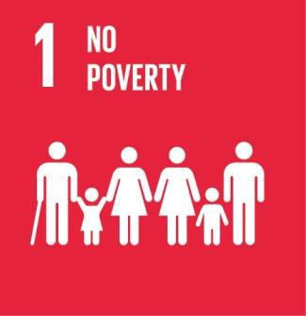


FROM MDGs TO SDGs: SUCCESSES AND CHALLENGES
Poverty rate using the new national poverty line 2011-2015,
declined from 14.2 percent in 2010 to 4.5 percent in 2015.
The hunger rate dropped dramatically over the past fifteen years and chronic hunger as a phenomenon has been eradicated in most provinces in Viet Nam
The Under-five Mortality Rate halved between 1990 and 2014 while the
Infant Mortality Ratio (IMR) fell rapidly by 2.5 times over the same period. HIV prevalence has been reduced to under 0.3% of the population.
Viet Nam has achieved the goal for controlling malaria since 2011 with the proportion of malaria-related deaths standing at only 0.01 per 100,000
people in 2012. Viet Nam has achieved significant progress in the reduction of the maternal Mortality ratio.

Slide 23


FROM MDGs TO SDGs: SUCCESSES AND CHALLENGES (Cont.)
By 2014, there was no significant difference between literacy rate and education attainment across all educational levels between males and females. In higher education (university and colleges), the percentage of male and female lecturers are now close to equal. Ratio of wages (the wage gap)
between male and female workers in non-farm sector has been narrowed
to 106.7% in 2014.
Viet Nam has achieved solid results in developing a global partnership for development. The past years have witnessed rapid liberalization of trade; a number of major Free Trade Agreements have been signed, with the more recent ones driving deeper integration of Viet Nam within the global
economy.

Slide 24
CHALLENGES FOR SDGs IMPLEMENTATION
1. Facing major social and demographic changes.
2. Property has been remained prevalent in remote and mountainous areas.
3. Climate change has become visible.
3. Natural resources has been degrading. Environmental pollution has also been increasing.
4. Institutional framework for SDG (monitoring, reviewing and reporting) is still weak.

Slide 25
OVERALL OBJECTIVE TO 2030
Sustaining economic growth in parallel with ensuring social progress and justice and ecological environment protection, effective management and utilization of natural resources, proactively respond to climate change; ensuring that all citizens fully develop their potentials, participate in and equally benefit from development achievements; building a prosperous, peaceful, inclusive, democratic, equitable, civilized, and sustainable Viet Nam.

Slide 26
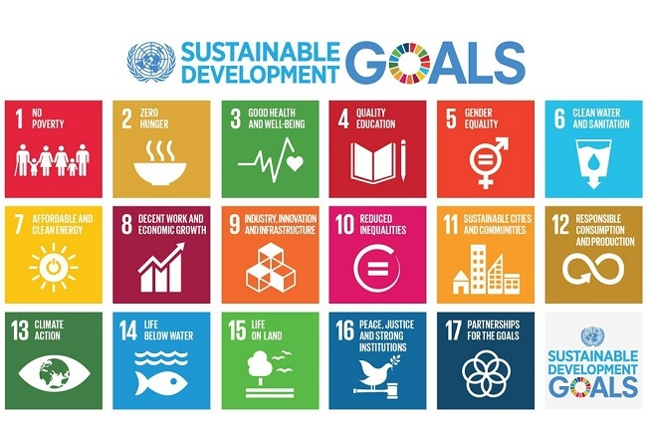
VIET NAM SUSTAINABLE DEVELOPMENT
GOALS BY 2030

Slide 27
KEY TASKS TO BE IMPLEMETED DURING 2017-2020
Improve: Institutional system; Efficiency of state management;
Legal system.
Preparing Action Plans in order to implement VSDGs to 2030.
Undertaking communication, advocacy and education activities.
Strengthening the capacity.

Slide 28
KEY TASKS TO BE IMPLEMETED DURING 2021 - 2030
Preparing and issuing specific targets and a roadmap for the implementation
of SDGS until 2030 (statistical criteria, mechanism for data collection,
monitoring, evaluating the implementation of Viet Nam’s SDGs).
2. Mainstreaming sustainable development goals.
3. Developing human resources, particularly high quality human resources.
4. Overseeing, evaluating and reporting on the implementation of sustainable
development goals.

Slide 29
SUSTAINABLE DEVELOPMENT
MONITORING PROGRESS
The feasibility of 230 indicators
- 129/230 indicators are feasible;
101/230 indicators are infeasible.
Baseline/data base - 89/230 indicators have available data - 141/230 indicators have no available data.
Indicator integration into national statistical system 30 indicators have been integrated into the 2015 Statistics Law

Slide 30
MONITORING AND REVIEWING MECHANISM
GOVERNMENT
NATIONAL COUNCIL FOR SUSTAINABLE DEVELOPMENT
MPI/LINE MINISTRIES
PROVINCES/LOCAL AUTHORITIES
SOCIAL ORGANIZATIONS/ BUSINESS SECTOR

Slide 31
NEXT STEPS FOR VSDG MONITORING
AND REVIEWING
1. Develop VSDG indicators (concepts, contents, calculation methods to
ensure the national ownership of data).
2. Setting up VSDG indicators monitoring system.
3. Adding VSDG to national statistic list.
4. Developing the online indicator information systems for SDG monitoring and reporting.
5. Enhancing capacity of statistics for SDGs (staff of the GSO and other line
ministries, sectors as well as local level).
6. Mobilizing technical and financial support for monitoring and reviewing

Slide 32
THANK YOU FOR YOUR
ATTENTION!

