Slide 1

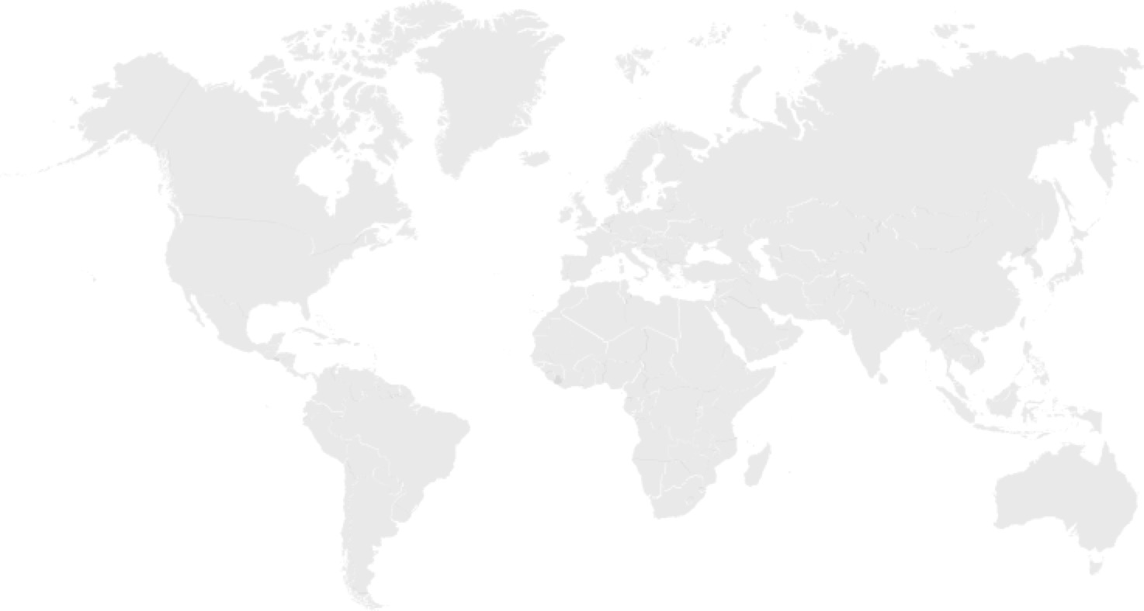
澜沧江-湄公河环境合作战略框架 Lancang-Mekong Environmental Cooperation Strategic Framework
澜沧江-湄公河环境合作中心
Lancang-Mekong Environmental Cooperation Center

Slide 2
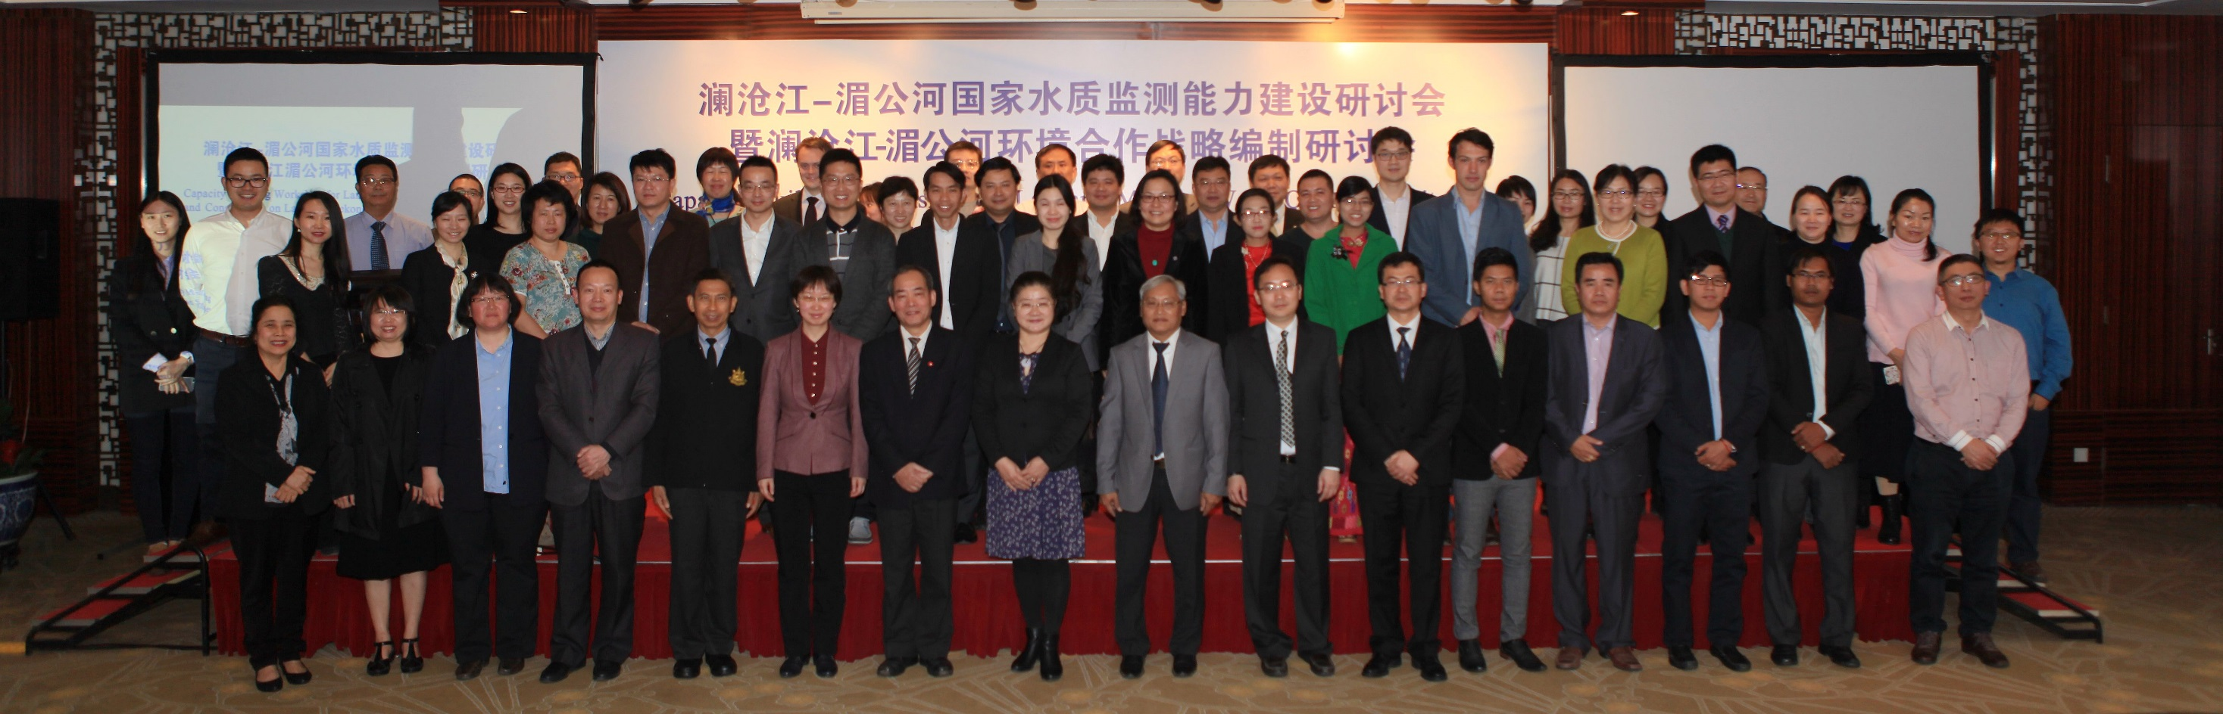
工作进展 Progress
2017年3月31日在北京召开澜沧江-湄公河环境合作战略编制研讨会
March 31, 2017, Consultation on Lancang-Mekong Environmental Cooperation Strategy was held in Beijing.
2017年4月至7月，根据参会代表意见修订战略框架文本
April to July of 2017, revised the document according to suggestions in the workshop.
2017年8月14日-9月10日，将战略框架修订版本发送湄公河国家及国际组织征求意见（汇总意见请见表格）
During 14 August to 10 September of 2017, send the revised version to colleagues of Mekong countries and NGOs for further comments (Please find the detailed comments in the comments matrix)

Slide 3
意见汇总 Comments Matrix
国家/组织Stakeholders | 针对条目Targeted Parts | 具体意见Comments | 回应Response
柬埔寨Cambodia |  | 无意见（Mr. Him Chandath）
老挝 Lao PDR | 词汇使用 wording | 1, use “2030 Agenda for Sustainable Development, which includes a set of 17 United Nations Sustainable Development Goals (SDGs)” instead of “2030 Sustainable Development Agenda”； 1、背景中“2030年可持续发展议程”改为包含17个联合国可持续发展目标的2030年可持续发展议程； 2, use “brought a great pressure to the environmental condition and its ecological systems in the region” instead of “brought a great pressure to the rich fragile ecological environment for the region” in Page 2; 2,合作回顾中“…对区域内丰富而脆弱的生态环境带来了巨大的压力”改为“给区域环境状况和生态系统带来了巨大压力” 3,将非政府组织统一简称为“NGOs” 3,use “NGOs” for short | 采纳 Accepted

Slide 4
意见汇总 Comments Matrix
国家/组织Stakeholders | 针对条目Targeted Parts | 具体意见Comments | 回应Response
老挝 Lao PDR | 合作原则 Cooperative Principles | “采取共建、共享、互惠互利的合作原则”，建议改为“在互相理解的基础上采取共建、获取与惠益的合作原则” use “Following the principles of joint construction, access and benefit-sharing on a basis of mutual understanding”instead of “Following the principles of joint construction, sharing and mutual benefit” | 采纳 Accepted
 | 优先合作领域 Priority Areas | 5.2—1）环境管理人员综合能力培训 建议改为“通过组织澜沧江-湄公河环境规划与管理培训项目以及环境部门领导能力培训加强能力建设” 5.2 Environmental Capacity Building 1, use “To enhance capacity building through organizing Lancang-Mekong environmental planning and management training programs as well as the leadership skill training for environmental sector” instead of “To organize Lancang-Mekong environmental management personnel comprehensive capacity trainings, improving regional environmental planning and executive capacity” ; 2, adjust wording “strengthen the public awareness raising of environmental issues in the Lancang-Mekong Countries” | 采纳 Accepted

Slide 5
意见汇总 Comments Matrix
国家/组织Stakeholders | 针对条目Targeted Parts | 具体意见Comments | 回应Response
老挝 Lao PDR | 优先合作领域 Priority Areas | 5.3 生态系统管理与生物多样性保护 5.3 Ecosystem Management and Biodiversity Conservation 建议增加： 1）实施管理自然资源/生物多样性的善治，确保获取和惠益分享（ABS）以及促进澜沧江－湄公河国家生物多样性产品（BBP）项目的实施 1, add “To apply good governance for the management of natural resources/biodiversity in order to secure the Access and Benefit-Sharing (ABS) as well as promoting Biodiversity-based Product (BBP) project implementation within Lancang-Mekong Countries.” | Accepted 采纳
 |  | 5.4 气候变化适应与减缓 建议增加： 1）提高澜沧江-湄公河国家公众应对气候变化意识; 2）促进和加强澜沧江－湄公河国家社区气候变化适应型投资项目。 To promote and strengthen the climate change resilient investment projects in the local communities of the Lancang-Mekong countries. | Partially accepted部分接受 环境教育与公众环境意识单独列为优先领域之一 List public awareness as one of the priorities

Slide 6
意见汇总 Comments Matrix
国家/组织Stakeholders | 针对条目Targeted Parts | 具体意见Comments | 回应Response
老挝 Lao PDR | 合作形式 Forms of Cooperation | 建议增加“适当情况下，特殊领域以双边合作形式开展” 1, add one paragraph in the beginning “The cooperation and collaboration on environment among Lancang-Mekong countries will be conducted in the form of multilateral cooperation through:” 2, add “However, the bilateral cooperation on specific areas between two certain countries may be made when appropriate” | Accepted 采纳
缅甸Myanmar |  | In the progress of reviewing
泰国Thailand |  | No Comments（Mr. Chao Nokyoo）无意见
越南Viet Nam |  | In the progress of reviewing

Slide 7
国家/组织Stakeholders | 针对条目Targeted Parts | 具体意见Comments | 回应Response
The Nature Conservancy | Priority Areas 5.3 Ecosystem Management and Biodiversity Conservation | Add： 1, to carry out terrestrial / freshwater ecosystem protection priority area identification, providing scientific basis for the regional ecosystem management, trans boundary nature reserves and ecological corridor construction, and conservation of species throughout. 2, to promote integrated watershed planning that takes into account both development utilization of water resources and ecological protection. 3, add “to promote endangered species range-wide protection.” | Partially accepted
Conservation International Foundation | Wording | Coherence of words, like “ the Lancang-Mekong Countries”, “NGOs” etc. | Accepted
 | Priority Areas | 5.3 Ecosystem Management and Biodiversity Conservation-5) Questions: is there a specific plan for trans boundary natural protection areas and ecological corridor construction? This needs more in-depth biodiversity assessment | Much work and projects has been done there. Specific plan will be made after the strategic framework was endorsed.
 |  | Add the environmental education as one of the priority areas. | Accepted
 | Implementation Mechanism | Suggest to consider signing MOU of declaration to establish multilateral cooperation platform | Accepted. These are specific forms of cooperation and will be used by stakeholders.
 | Financial Mechanism | Suggest to add PES、REDD、impact investment | Partially accepted. They are just part of what we have listed.
 | Institutional Arrangement | Suggest to add non-governmental environmental cooperation | Accepted. Cooperation with NGOs has been listed.
Stockholm Environment Institute Asia Centre | Priority Areas | Suggest to develop cooperative targets and related activities aligned with SDGs for each focus area; Suggest that targets and focus areas should be reassessed on a regular basis throughout the strategy period. | Accepted. Priorities areas listed now are related to the SDGs such as the urban environment governance etc. and regional environment hotspot. specific targets will be listed later on.
 | Implementation Mechanism | Suggest to define the role of international partners, CSO, NGOs, private sector, etc. in the strategy to support LMECC and its country partners Suggest to develop a comprehensive Monitoring & Evaluation(M&E) and program management plan; Suggest to discuss the institutional arrangements needed to implement the framework in each partner country, such as secretariat, focal agencies, and advisory board. | Accepted. Specific cooperation forms could be flexible for different partners. After discussing the framework, M&E and concrete program management including focal points could be made then.

Slide 8
绿色澜湄计划 Green Lancang-Mekong Initiative
澜沧江-湄公河环境合作中心将组织实施“绿色澜湄计划”旗舰项目，具体推动澜沧江-湄公河环境合作项目设计与实施。主要包括：
澜湄环境合作政策对话，环境政策主流化，环境能力建设，环境示范项目，环境合作伙伴关系
Green Lancang-Mekong Initiative is a flagship program to implement the Lancang-Mekong Environmental Cooperation Strategy. It includes:
Lancang-Mekong Environmental Cooperation Policy Dialogue, Mainstreaming of Environmental Policy, Environmental Capacity Building, Environmental Demonstration Cooperation, Environmental Cooperation Partnership

Slide 9
合作目标 Cooperative Objectives
促进次区域的可持续发展
To facilitate regional sustainable development
推动澜沧江－湄公河生态环境保护合作
To promote Lancang-Mekong ecological environmental protection cooperation:
提供区域环境与发展政策对话平台
To establish the platform of Lancang-Mekong Environmental Policy Dialogues
提升区域环境管理能力
To improve regional environmental management capacity

Slide 10
合作原则 Cooperative Principles
1）注重合作的长期性、稳定性与可持续性；
Emphasizing secular, stable and sustainable cooperation
2）合作应充分考虑澜沧江－湄公河沿线各国自身国情和发展阶段情况；
Taking full account of national conditions and development stages of the Lancang-Mekong Countries
3）在互相理解的基础上采取共建、获取与惠益的合作原则；
Following the principles of joint construction, access and benefit-sharing on a basis of mutual understanding
4）秉持开放、包容的精神，与现有区域合作机制互相补充、协调发展；
Adhering to the spirit of tolerance, supplementing and coordinating with existing regional cooperation mechanism
5）在澜沧江－湄公河国家环境主管部门的职权范围内开展平等的对话与合作；
Adopting equal dialogues and cooperation within the terms of reference of environmental authorities of the Lancang-Mekong Countries
6）欢迎其他国际和地区组织、非政府组织、私营部门等机构的共同参与。
Being open to the joint participation of other international and regional organizations, NGOs, private sectors and etc

Slide 11
优先合作领域 Priority Areas

Slide 12
优先领域 Priority Areas
澜沧江-湄公河环境合作
Lancang-Mekong Environmental Cooperation
环境能力建设计划
Environmental Capacity Building Plan
生态系统管理与生物多样性保护
Ecosystem Management and Biodiversity Conservation
环境友好型技术交流与环保产业合作
Environmentally friendly technology communication and environmental protection industrial cooperation
气候变化适应与减缓Climate Change Adaptation and Mitigation
城市环境治理
Urban Environmental Governance
农村环境治理
Rural Environmental Governance
环境政策主流化Mainstreaming Environmental Policies
环境数据与信息管理Management of Environmental Data and Information
环境教育与公众环境意识 Environmental Education and Public Awareness

Slide 13
1、环境政策主流化 Mainstreaming Environmental Policies
开澜沧江-湄公河区域环境合作与2030年可持续发展议程高层政策对话；
high-level policy dialogues on Lancang-Mekong environmental cooperation and 2030 Sustainable Development Goals
开展澜沧江－湄公河环境政策体系、环境合作展望等联合研究
Joint research on environmental poly , environmental cooperation outlook
开展跨部门政策对话与政府－企业圆桌对话
Trans-departmental dialogue and government-enterprises round-table dialogue

Slide 14
2、环境能力建设计划 Environmental Capacity Building Plan
提高区域环境规划能力与环境管理能力
enhance capacity building through organizing Lancang-Mekong environmental planning and management training programs as well as the leadership skill training for environmental sector trainings
环境技术官员能力建设活动
launch technical official capacity building activities
开展基于多方合作的能力建设项目
launch capacity building projects on multiple cooperation
适时组织澜沧江－湄公河企业圆桌对话
To organize the Lancang-Mekong Enterprises Roundtable Dialogue appropriately.

Slide 15
3、生态系统管理与生物多样性保护 Ecosystem Management and Biodiversity Conservation
联合研究
Joint research
综合规划开发建设
Planning and construction
调查、监测与评估
Investigation, monitoring and assessment
公约履约
Implementation of conventions

Slide 16
4、气候变化适应与减缓 Climate Change Adaptation and Mitigation
环保与气候变化关系性研究joint research on relevance of environmental protection and climate change adaptation and mitigation
绿色园区与社区
low carbon and green industrial parks and communities
应用平台与良好实践指南
technological infrastructure cooperation platform and good practice guidelines
气候适应型投资
climate change resilient investment

Slide 17
5、城市环境治理 Urban Environmental Governance
城市环境治理
Urban environmental governance
城市环境规划合作
blueprint cooperation
水环境治理
urban water environment management
机动车尾气排放监测与治理
monitoring and management of motor vehicle emissions
城市垃圾管理
municipal waste management
城市可持续发展伙伴关系网络圾治理
Lancang-Mekong urban sustainable development partnership network

Slide 18
6、农村环境治理 Rural Environmental Governance
农村环境治理
Rural Environmental Governance
农村环境政策对话
rural environmental policy dialogue
技术合作
Technology cooperation
农业生产污染示范项目合作
agriculture-caused pollution management demonstration project
农村废弃物资源化利用
promote resource utilization

Slide 19
7、环境友好型技术交流与环保产业 Environmentally friendly technology communication and environmental protection industrial
环境产业与技术需求清单联合调查研究
joint investigation and research on requirement list of environmental industry and technology
构建区域环境政府和社会资本合作交流平台
establish regional communication platform of government and social capital
生态工业园区合作
propel cooperation of Lancang-Mekong Eco-industrial Park

Slide 20
8、环境数据与信息管理 Management of Environmental Data and Information
环境数据与信息Environmental information
能力建设
capacity building activities
环境信息共享活动
environmental sharing activities
环境智库知识分享与交流对话
knowledge sharing and communication dialogue among think tanks

Slide 21
9、环境教育与公众环境意识 Environmental Education and Public Awareness
提高澜沧江－湄公河国家公众环境意识
strengthen public environmental awareness
建立澜沧江－湄公河环境教育网络
establish the Lancang-Mekong Environmental Education Network
开展澜沧江－湄公河环境合作青年论坛
organize the Lancang-Mekong Environmental Youth Forum

Slide 22
资金机制
Funding
澜沧江-湄公河合作专项基金Lancang-Mekong Cooperation Fund
1、澜沧江-湄公河国家提供的资金
support from Lancang-Mekong countries
2、国际发展伙伴和第三国提供的资金
support from international partners and third countries
3、企业资金
support from enterprises
4、其他
others

Slide 23
Thank you for your attention

