Slide 1
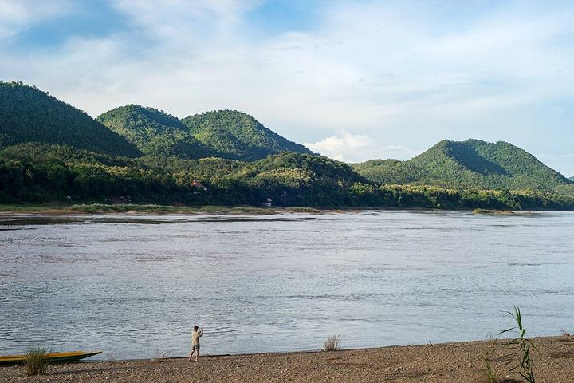
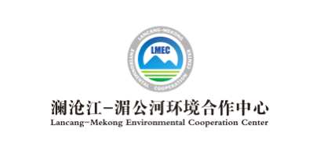
Newsletter
Issue 6, 2021 April 10, 2021
Lancang-Mekong Roundtable Dialogue on Regional and Global Environmental Governance:
Action on Climate Change and Sustainable Infrastructure
Session 2: Lancang-Mekong Cooperation on Climate Change and Water Environment Governance Successfully Held
On April 8, 2021, Session 2: Lancang-Mekong Carbon Neutrality Initiative: Sharing of Innovative Energy Solutions of the Lancang-Mekong Roundtable Dialogue on Regional and Global Environmental Governance: Action on Climate Change and Sustainable Infrastructure, one of a series of activities celebrating the 5th anniversary of the Lancang-Mekong Cooperation (LMC), was successfully held both online and offline. During the session, participants shared their views on the construction of drinking water and sanitation facilities in the Lancang-Mekong sub-region amidst climate change, Lancang-Mekong “Water-Energy-Food Nexus (WEF Nexus)” practice and development trend, development of Lancang-Mekong countries into low-carbon societies, climate-resilient cities and eco-environmental solutions in these countries, water environment governance practices in Lancang-Mekong countries in the context of climate change and low-carbon industrial park and water environment governance practices in the sub-region, and had heated discussions on the direction of future cooperation. Below is a summary of expert opinions:
Mr. Evariste Kouassi-Komlan, Regional Adviser, Water, Sanitation and Hygiene at the United Nations International Children’s Emergency Fund (UNICEF), indicated that sewage treatment in the Lancang-Mekong sub-region is now challenged by climate change, and measures such as exploring climate-resilient intelligent solutions, encouraging investment from the private sector and building capacity for water supply and sanitation services can be taken to drive the development of climate-resilient infrastructure and realize the Millennium Development Goals.
Ms. Chayanis Krittasudthacheewa, Deputy Director, Asia Center, Stockholm Environment Institute, introduced that Lancang-Mekong countries have fully considered the “WEF Nexus” when developing their economic development plans, and enhanced water, energy and food security through technological exchanges and data sharing in international cooperation. Countries in the sub-region can identify key points of structural transformation through the “WEF Nexus”, develop adaptation policies and keep sharing information and knowledge, with a view to promoting sustainable resource management in each country and throughout the sub-region.

Slide 2
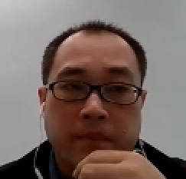
Lancang-Mekong Environmental Cooperation Newsletter
Mr. Yoeung Visal, Assistant Secretary of State, Ministry of Environment of Cambodia, explained that Cambodia evaluates the results of biodiversity conservation by monitoring changes in populations of endangered birds and cranes, mapping the distribution of birds and conducting water quality monitoring. In terms of wetland ecosystem management, Cambodia focuses on promoting the protection of wetlands and drinking water sources at ministry and department levels to prevent illegal appropriation of land and environmental destruction.
Mr. BounEua Khamphilavanh, Deputy Director for Greenhouse Gas Emission and Mitigation, Department of Climate Change, Ministry of Natural Resources and Environment of Lao PDR, said that Lao PDR will build an energy efficiency data center, launch carbon credit registration and have projects certified with emissions reduction credits based on the vision of green economic growth and sustainable resilient development. Meanwhile, Lao PDR will strive to move towards low-carbon emissions by developing an urban low-carbon development strategy and facilitating the development of clean and environmentally-friendly technologies.
Mr. Teerapong Laopongpith, Environmental Expert, Office of Natural Resources and Environmental Policy and Planning, Ministry of Natural Resources and Environment of Thailand, presented the country’s current elastic strategy against climate change, long-term climate change plan for 2015-2050 and national adaptation plan. He also shared Thailand’s practice in the development of mechanisms and tools to address climate change through a case study of pilot zones for nature-based solutions and capacity building activities in Thailand, thus providing a reference for the construction of climate-resilient cities in Lancang-Mekong countries.
Mr. Chen Yaxiang, Associate Research Fellow, Lancang-Mekong Environmental Cooperation Center (LMEC), indicated that as low-carbon energy transformation and reduction of environmental impacts are important development directions of industrial parks, Lancang-Mekong countries should focus on cooperation and sharing of water governance standards and good practices, enhance the exemplary role of Lancang-Mekong low-carbon industrial parks, diversify regional carbon neutrality paths for key industries and enterprises, and promote climate change and water governance capacity building and demonstration in the sub-region.
In the Comments & Discussions part, Mr. Truong Hong Tien, Deputy Director, Vietnam National Mekong Committee pointed out that climate change is giving rise to increasingly frequent extreme weather events, requiring countries in the sub-region to strengthen dialogue, share hydrological data and dam information, and establish an emergency response system to meet the common challenge of climate change. Further, in the light of the commitments to addressing climate change made by the countries in the Kyoto Protocol, developing and developed countries should extend cooperation. Developed countries are expected to give support to the Lancang-Mekong sub-region in facilitating the sustainable development of economic and environmental services in the sub-region.
Mr. Mei Jiayong, Director, China Programme at Oxfam, said that Lancang-Mekong countries have done a lot in promoting sustainable development and set their respective sustainable development goals, and should further share experience with each other, step up discussions on the impact of climate change on the poor and women’s rights, and achieve sustainable community development goals.
In her conclusion of the session, Ms. Li Xia, LMEC Director, said that the LMEC is committed to providing a platform for open discussions and knowledge sharing for regional response to climate change. She expected that the LMC community could continue to enhance exchanges, jointly identify regional environmental and climate challenges, explore paths of pragmatic cooperation in nature-based solutions and ultimately realize sustainable regional development.
Contact Us
Lancang-Mekong Environmental Cooperation Center
Foreign Environmental Cooperation Center, Ministry of Ecology and Environment
Address: No.5 Houyingfang Hutong, Xicheng District, Beijing, 100035, P. R. China
Tel: +86-010-82268277/8221
Fax: +86-010-82200579
E-mail: tang.huaqing@fecomee.org.cn
li.xia@fecomee.org.cn
Web: http://www.lmec.org.cn
WeChat ID: lancang-mekongec
About LMEC: Lancang-Mekong Environmental Cooperation Center (LMEC) is an initiative proposed by Chinese Premier Li Keqiang at the 1st Lancang-Mekong Cooperation Leaders’ Meeting in March 2016. Officially inaugurated in November 2017 in Beijing, the LMEC aims at advancing cooperation on ecological and environmental protection among Lancang-Mekong countries, providing a platform for environmental and development dialogue, enhancing regional environmental management capacity, facilitating regional environmental cooperation and pushing forward regional sustainable development in a concerted manner.

