Slide 1
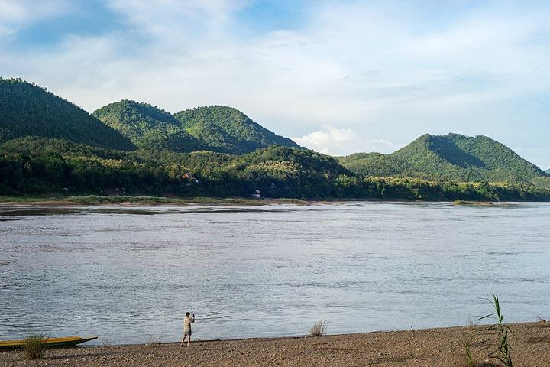
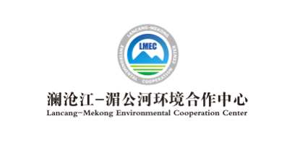
Newsletter
Issue 6, 2021 April 9, 2021
Lancang-Mekong Roundtable Dialogue on Regional and Global Environmental Governance:
Action on Climate Change and Sustainable Infrastructure
Session 1: Lancang-Mekong Carbon Neutrality Initiative: Sharing of Innovative Energy Solutions and Expert Opinions
On April 8, 2021, Session 1: Lancang-Mekong Carbon Neutrality Initiative: Sharing of Innovative Energy Solutions of the Lancang-Mekong Roundtable Dialogue on Regional and Global Environmental Governance: Action on Climate Change and Sustainable Infrastructure, one of a series of activities celebrating the 5th anniversary of the Lancang-Mekong Cooperation (LMC), was successfully held both online and offline. During the session, participants shared their views on the prospects for renewable energy and sustainable infrastructure development in Lancang-Mekong countries, cases of urban greenhouse gas (GHG) emission reduction in these countries, opportunities and challenges for power connectivity in the Lancang-Mekong sub-region, sustainable energy innovation schemes for textile industrial parks in the Lancang-Mekong River Basin and high-quality regional development driven by the Lancang-Mekong Knowledge Sharing Platform for Low-Carbon and Sustainable Infrastructure, and had heated discussions on the direction of future cooperation. Below is a summary of expert opinions:
Ms. Miao Hong, Sustainable Investment Program Director, WRI China, noted that fully sharing China’s experience in energy development over the years with other Lancang-Mekong countries and promoting coordination and cooperation on regional sustainable energy projects is of great significance to efficient energy use and green development in the region. Moreover, piloting climate financing and establishing a more inclusive sustainable infrastructure investment market can better contribute to multi-party cooperation, energy transformation and regional green recovery.
Ms. Sumon Sumetchoengprachya, Director, Carbon Business Office, Thailand Greenhouse Gas Management Organization (TGO), said that provinces in Thailand have developed carbon footprint reduction plans, and the emission reduction target has been decomposed. Meanwhile, local data platforms have been established, where local authorities enter and report data on GHG emissions and reductions to ultimately form a general report on GHG emissions in Thailand. On this basis, Thailand can organize capacity building, define the overall emission reduction target, assess emission reduction measures and potential, urge cities to develop their respective action plans for emission reduction, and expedite low-carbon transformation of the mode of production.

Slide 2
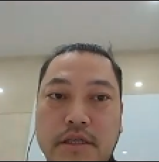
Lancang-Mekong Environmental Cooperation Newsletter
Mr. Lei Xiaomeng, Senior Expert, China Electricity Council, introduced that the Lancang-Mekong sub-regional power cooperation mechanism is already mature, while regional power systems are facing the challenge of low-carbon and renewable energy transformation. On the other hand, long-term bilateral and multilateral low-carbon energy cooperation entails analysis and research on technology, economy, externality and environmental sociology, with due regard to energy development plans of Lancang-Mekong countries. He expected Lancang-Mekong countries to share their experience, support sustainable energy development and enhance regional power connectivity.
Mr. Hu Kehua, Director, Sustainable Development and Cooperation Department, China Textile Information Center, pointed out that China’s textile industry is actively exploring ways to reduce its negative externalities, developing a prediction model in view of production capacity growth and carbon emission reduction to guide different niches to set bottom-up emission reduction targets, and formulating a carbon neutrality roadmap. As the textile industry links sustainable production and consumption, regional carbon neutrality can be achieved through exploring the value of the whole industry chain in combating climate change, encouraging enterprises to reduce carbon emissions and sharing with Lancang-Mekong countries sustainable and innovative emission reduction technologies.
Mr. Qian Zhaohui with the Lancang-Mekong Environmental Cooperation Center (LMEC) explained that the Lancang-Mekong Knowledge Sharing Platform for Low-carbon and Sustainable, a key project of the LMEC, will develop into an open knowledge sharing platform for both Lancang-Mekong countries and the international community by relying on the “Green Lancang-Mekong Initiative” and focusing on standards, guidelines, techniques and good practices concerning low-carbon and sustainable infrastructure investment and construction, in a bid to boost low-carbon and sustainable investment and trade in the Lancang-Mekong sub-region and power high-quality regional development.
In the Comments & Discussions part, Mr. Sounadeth Soukchaleun, Deputy Director for Planning and Finance, Ministry of Natural Resources and Environment, Lao PDR, stated that the LMEC is a good platform promoting regional environmental cooperation. The Lao side hopes to continue cooperation on climate change and water governance with China, exchange and share environmental data, initiate project financing and make concerted efforts to promote ecological progress and sustainable growth.
Mr. Ma Dingping, Secretary General, Chongqing Renewable Energy Society, argued that a combination of energy conservation measures and renewable energy uses is an important direction towards which industrial parks will develop. In this sense, it is essential to build the Lancang-Mekong Knowledge Sharing Platform for Low-carbon and Sustainable Infrastructure, whereby Lancang-Mekong countries can have long-term access to detailed information and learn from each other. Additionally, he also hoped that the platform could bring into full play the initiative of local authorities, enable full exchanges between local small and medium-sized enterprises (SMEs) and Lancang-Mekong countries, and enhance sustainable trade contacts.
In her conclusion of the session, Ms. Li Xia, LMEC Director, said that ensuring energy efficiency and accessibility in the Lancang-Mekong sub-region by financial means should be an important direction of the regional response to climate change. The LMEC will remain committed to promoting regional dialogue and continue to fuel regional inclusive growth by sharing the experience of different countries. In the future, more partners are expected to join the LMC and work hand in hand to address climate change and pursue sustainable development.
Contact Us
Lancang-Mekong Environmental Cooperation Center
Foreign Environmental Cooperation Center, Ministry of Ecology and Environment
Address: No.5 Houyingfang Hutong, Xicheng District, Beijing, 100035, P. R. China
Tel: +86-010-82268277/8221
Fax: +86-010-82200579
E-mail: tang.huaqing@fecomee.org.cn
li.xia@fecomee.org.cn
Web: http://www.lmec.org.cn
WeChat ID: lancang-mekongec
About LMEC: Lancang-Mekong Environmental Cooperation Center (LMEC) is an initiative proposed by Chinese Premier Li Keqiang at the 1st Lancang-Mekong Cooperation Leaders’ Meeting in March 2016. Officially inaugurated in November 2017 in Beijing, the LMEC aims at advancing cooperation on ecological and environmental protection among Lancang-Mekong countries, providing a platform for environmental and development dialogue, enhancing regional environmental management capacity, facilitating regional environmental cooperation and pushing forward regional sustainable development in a concerted manner.

