Slide 1
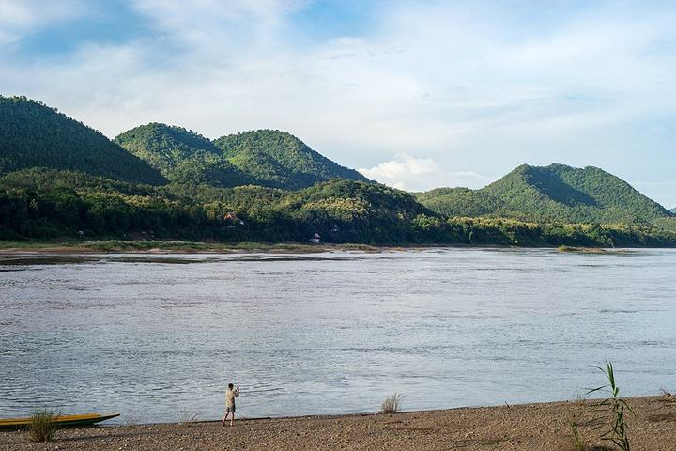
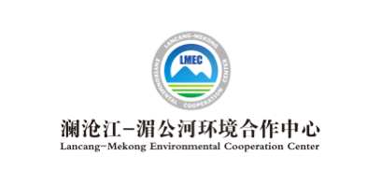
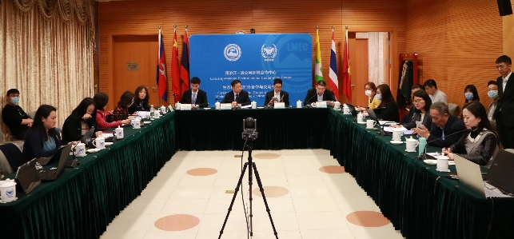
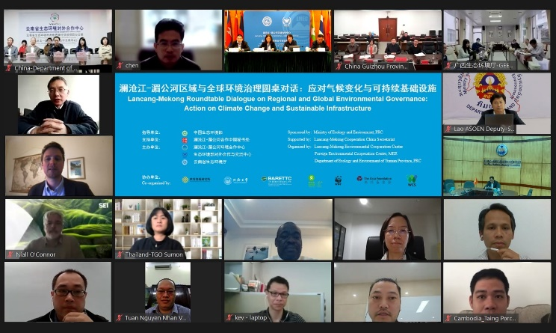
Newsletter
Issue 4, 2021 April 8 2021
Lancang-Mekong Roundtable Dialogue on Regional and Global Environmental Governance: Action on Climate Change and Sustainable Infrastructure was Successfully Held
Lancang-Mekong Roundtable Dialogue on Regional and Global Environmental Governance: Action on Climate Change and Sustainable Infrastructure, one of several activities marking the fifth anniversary of Lancang-Mekong Cooperation (LMC), was successfully held both online and offline on April 8, 2021. The roundtable dialogue was guided by the Ministry of Ecology and Environment (MEE), supported by LMC China Secretariat, co-hosted by Foreign Environmental Cooperation Center (FECO)/Lancang-Mekong Environmental Cooperation Center (LMEC) and Department of Ecology and Environment of Yunnan Province
And co-organized by the World Resources Institute, Tongji University, the Belt and Road Environmental Technology Exchange and Transfer Center (Shenzhen), Oxfam, World Wide Fund for Nature, Asia Foundation, and Wildlife Conservation Society, with representatives from MEE and its affiliated institutions, embassies of Mekong countries in China, climate and environment departments of Mekong countries, international organizations, research institutes and enterprises attended the meeting.
The Roundtable Dialogue was attended by many government officials with opening remarks, including LI Yonghong, Deputy Director-General of FECO/LMEC, CHEN Zhihua, Director of the Department of Climate Change of MEE, Benjamin Sukanjanajtee, Minister of Royal Thai Embassy in China, and FANG Xiong, Deputy Director-General of Department of Ecology and Environment of Yunnan Province. Besides, keynote speeches were given on a series of topics, ranging from Green Finance Support the Construction of Climate Change Resilience Infrastructure and Good Practice Principles for Sustainable Infrastructure in Lancang-Mekong Region, by YE Yanfei, Counsel of Policy Research Bureau of China Banking and Insurance Regulatory Commission, and Rowan Palmer, Specialist of Green Econcomy Initiative at UNEP.

Slide 2
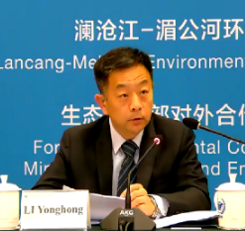
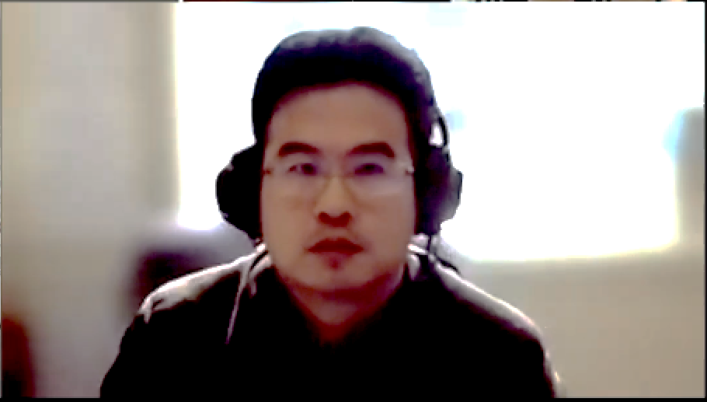
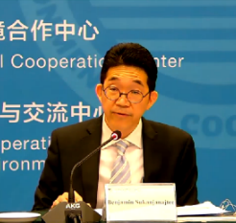
Newsletter for Lancang-Mekong Environmental Cooperation
In his speech, Mr. LI stated that the roundtable dialogue was designed to deepen policy exchange and experience sharing among Lancang-Mekong countries on climate change and sustainable infrastructure. It not only serves an important move to implement the leadership initiative, but also establishes a clear direction for further LMC. This year marks the fifth anniversary of LMC. As an active advocate in regional cooperation on environmental protection, China stands ready to work with Lancang-Mekong countries to promote the green and low-carbon development of the region on the basis of mutual benefits and win-win outcomes, and strives to inject sustained impetus into the sustainable development of the region.
In his remarks, Mr. CHEN highlighted that issues on climate change have been the key priority of LMC. China and Mekong Countries have sought diverse methods to facilitate the climate cooperation, in a bid to boost the regional capacity of climate response. Hopefully, progress will be accelerated in connecting, co-building and sharing the benefits of South-South Cooperation on Climate Change and Regional Environmental Cooperation Mechanism for Langcang-Mekong Region. Besides, efforts will be made to design the South-South Cooperation Plan for climate change in the Langcang-Mekong region. Emphasis will be given to the climate change and green & low-carbon development related areas, so as to jointly develop and implement cooperation projects tailored to regional realities.
In his speech, Mr. Benjamin stated that the Thai government has been devoted to the transformation towards an environment-friendly economy, so as to ensure green recovery in the post-pandemic era. Thailand looks forward to deeper regional cooperation on environment, and strengthening regional cooperation mechanism for mutual progress. It firmly believes that the environmental cooperation of Lancang-Mekong region will project huge significance on the global response to climate change and environmental challenges, adding fuel to the fulfillment of Paris Agreement and UN 2030 Agenda for Sustainable Development.
In his remark, Mr. FANG expressed that over the years, Yunnan province has taken full advantage of its geological superiority for practical cooperation with countries along the Mekong River. This year, the 15th meeting of the Conference of the Parties to the Convention on Biological Diversity (COP 15) will take place in Kunming, China. Yunnan is willing to enhance exchanges with countries along the Mekong River. It hopes to promote the joint researches on climate change, green and low- carbon development and biodiversity, and advance capacity building and demonstration cooperation projects. The objective is to build a Community of Shared Destiny for countries in the Lancang-Mekong region, so as to promote the ecological protection and sustainable development of the region.

Slide 3
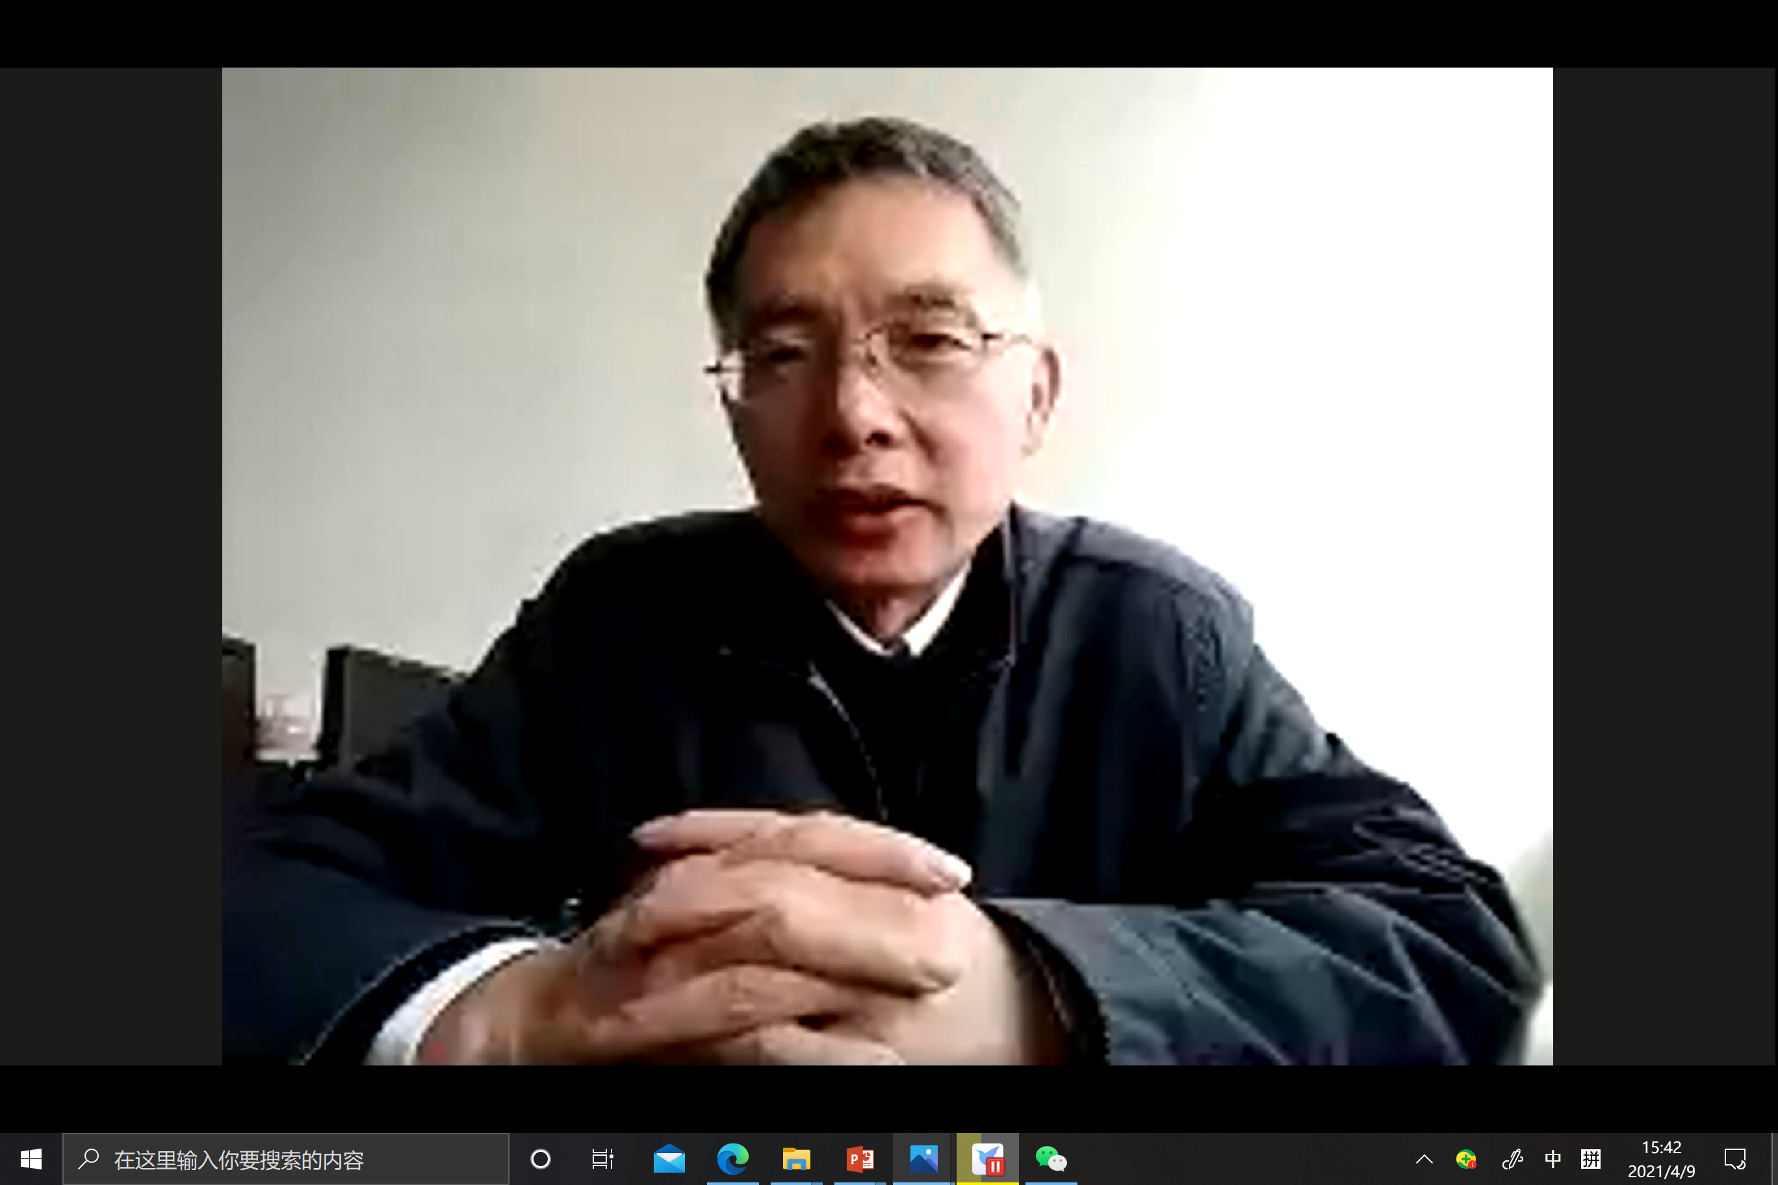
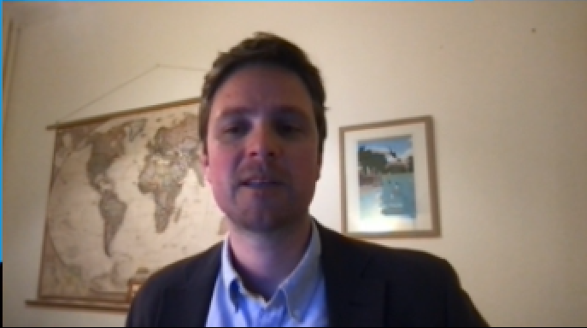
Newsletter for Lancang-Mekong Environmental Cooperation
Mr. YE briefed on the main activities that China have conducted through green financial to support climate-resilient infrastructure. He wished that Lancang-Mekong region could formulate carbon emission plan with full consideration of the carbon development goals of various countries in the region. Besides, he also hoped that the region could introduce international financial development institutes, such as the World Bank and the Asia Development Bank, into the financing process for sustainable infrastructure. The purpose is to form close partnership for regional cooperation, fully motivate the initiatives and strengths of various parties, so as to promote the sustainable construction and operation of regional infrastructures.
Mr. Rowan Palmer elaborated on International Good Practice Principles for Sustainable Infrastructure designed by the UNEP. The principles aim to facilitate the planning and operation of sustainable infrastructure projects through multiple perspectives, such as strategic planning, sustainable assessment of full life cycle, innovative financing, avoiding environmental impacts, resource efficiency and recycling utilization, transparent, inclusive and participative decision-making.
The roundtable dialogue focus on discussion over key regional environmental cooperation topics, such as climate change and building of sustainable infrastructure. The purpose is to enhance practical cooperation, increase the presence of environmental policies in legal systems, and accelerate the green & low-carbon development in the Lancang-Mekong region. This is how the event can promote the construction of regional sustainable infrastructure; enhance adaptation to and mitigation of climate change effects, and coordinate the implementation of United Nations 2030 Agenda for Sustainable Development. The event consists of two special forums: one on Carbon Neutrality Action in the Lancang-Mekong Region: Energy Innovation Solutions and Practice, the other one on Coordinated Cooperation for Climate Action and Water Environment Governance. During the event, participants have conducted deep exchanges and discussions on regional response to climate change, sustainable energy practice and sewage treatment in industrial parks.
The attendees unanimously hope to enhance exchanges and cooperation on climate change and sustainable infrastructure in the Lancang-Mekong region. Hopefully, further progress could be made in environmental and ecological projects, so that the climate and environmental cooperation network in the Lancang-Mekong region could be established. The ultimate purpose is to build consensus on green development, so as to encourage broad engagement in environmental cooperation in the region.
Contact Us
Lancang-Mekong Environmental Cooperation Center
Foreign Environmental Cooperation Center
Address: No. 5 Houyingfang Hutong,
Xicheng District, Beijing
100035, P.R. China
Tel: +86-010-82268277/8221
Fax: +86-010-82200579
Email: tang.huaqing@fecomee.org.cn
li.xia@fecomee.org.cn
Web：http://www.mepfeco.org.cn
WeChat ID: lancang-mekongec
About LMEC: Lancang-Mekong Environmental Cooperation Center (LMEC) is an initiative proposed by Chinese Premier LI Keqiang at the 1st Lancang-Mekong Cooperation Leaders’ Meeting and was established on November of 2017

