Slide 1
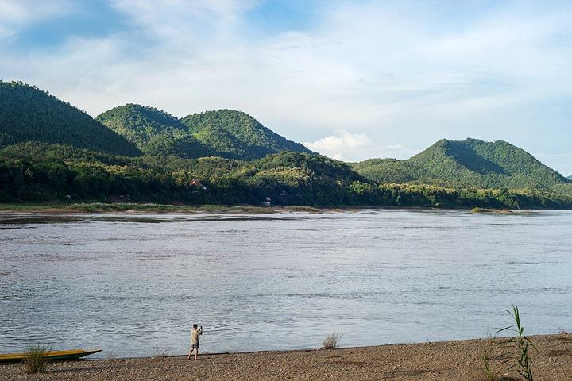
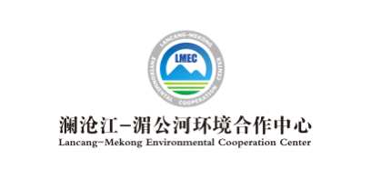
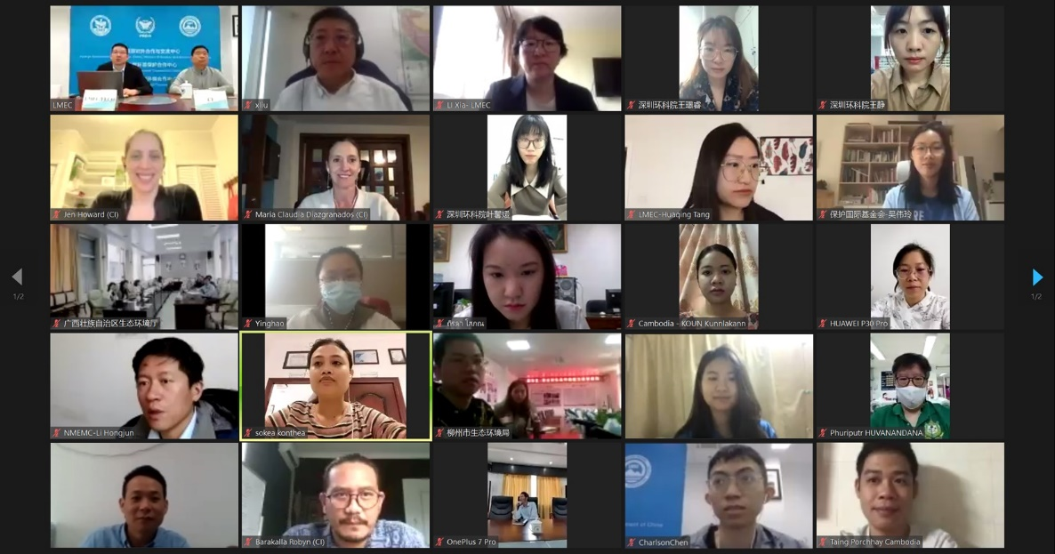
Newsletter
Issue 3, 2021 April 7 2021
Lancang-Mekong Knowledge Hub for Low-Carbon and Sustainable Infrastructure/ Knowledge Hub for South-South Cooperation on Climate Change: Low-Carbon and Eco-Environment
Capacity Building was Successfully Held
Lancang-Mekong Knowledge Hub for Low-Carbon and Sustainable Infrastructure/ Knowledge Hub for South-South Cooperation on Climate Change: Low-Carbon and Eco-Environment Capacity Building was successfully held both online and offline on April 7, 2021. The capacity building was guided by the Ministry of Ecology and Environment (MEE), hosted by the Foreign Environmental Cooperation Center (FECO)/ Lancang-Mekong Environmental Cooperation Center (LMEC), and co-organized by the Conservation International, with nearly 120 representatives from Ministry of Environment of Cambodia, Ministry of Natural Resources and Environment of Thailand, Thailand’s Greenhouse Gas Management Organization, Departments of Ecology and Environment of Zhejiang Province, Guangxi Zhuang Autonomous Region, Hainan Province and Guangdong Province of China. Ecology Environment Bureau of Shenzhen Municipality, China Quality Certification Centre and other institutions also participated.

Slide 2
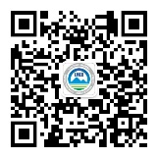
Newsletter for Lancang-Mekong Environmental Cooperation
Through sharing information on the Blue Carbon Program and the Nature-based Solutions applied in Colombia, this capacity building aims to raise the capacity of these participants to better exploit and manage climate program, better play the role of Nature-based Solutions in tackling global climate change, protecting biodiversity and improving community livelihoods, pragmatically enhance the capacity of Mekong countries and regions to take active part in global cooperation on climate change and eco-environment conservation, and step up the building of the Lancang-Mekong knowledge sharing platform for low-carbon and sustainable infrastructure and the knowledge sharing platform for south-south cooperation on climate change.
Jennifer Howard, the Senior Director of Blue Carbon Program at Conservation International, introduced the functions of the inshore ecosystem and its role in increasing global carbon sinks and boosting carbon neutrality. She also shared the information about the building of the development, financing, supervision mechanisms for the Blue Carbon Program and the specific ways the interested parties participate, in a bid to ensure the successful completion of the program.
By sharing the knowledge about the development flow and the running of practices of Nature-based Solutions, Maria Claudia Diazgranados Cadelo, an expert from Colombia, highlighted how to employ international standard methodology to optimize monitoring and certification for smooth program implementation, get more environmental and social sustainability certifications, improve climate benefits the program delivers and raise the price of carbon credits. She also discussed in depth with the participants the significance of the support from community residents to the sustainable operation of the program.
This capacity building is the first attempt to enhance capacity building for addressing climate change under the Lancang-Mekong Knowledge Sharing Platform for Low-Carbon and Sustainable Infrastructure and the Knowledge Sharing Platform for South-South Cooperation on Climate Change. In the future, we will continue to share more technical approaches and good practices to strengthen the capacity of the Lancang-Mekong region in mitigating and tackling climate change, thereby exploring more specific actions to boost carbon neutrality.
Contact Us
Lancang-Mekong Environmental Cooperation Center
Foreign Environmental Cooperation Center
Address: No. 5 Houyingfang Hutong,
Xicheng District, Beijing
100035, P.R. China
Tel: +86-010-82268277/8221
Fax: +86-010-82200579
Email: tang.huaqing@fecomee.org.cn
li.xia@fecomee.org.cn
Web：http://www.mepfeco.org.cn
WeChat ID: lancang-mekongec
About LMEC: Lancang-Mekong Environmental Cooperation Center (LMEC) is an initiative proposed by Chinese Premier LI Keqiang at the 1st Lancang-Mekong Cooperation Leaders’ Meeting and was established on November of 2017

