Slide 1
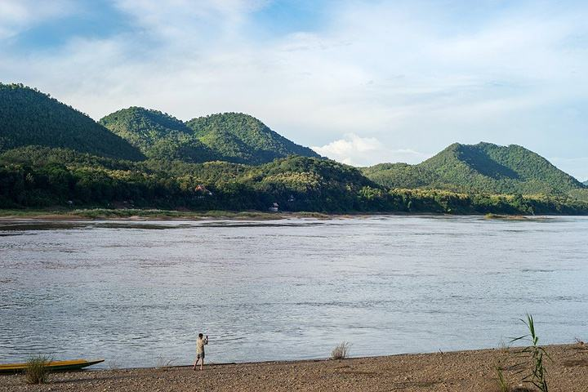
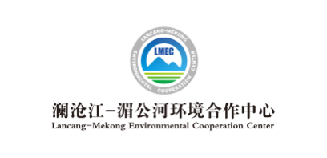
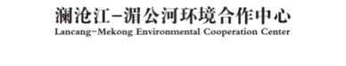

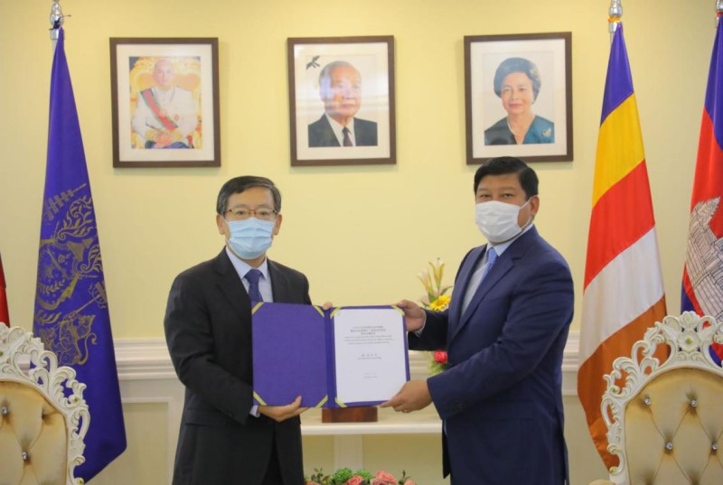
Newsletter
Issue 2, 2021 Jan. 24, 2021
Ceremony of Delivery of First Batch of Materials to the Cambodian Low-carbon Demonstration Zone Project of South-South Cooperation on Climate Change Held in Cambodia
The Cambodian Low-carbon Demonstration Zone Project of South-South Cooperation on Climate Change is one of the activities of the Green Lancang-Mekong Initiative, a flagship project launched by the Foreign Economic Cooperation Center (FECO) of the Ministry of Ecology and Environment (MEE) / the Lancang-Mekong Environmental Cooperation Center to improve the environmental governance capacity of Lancang-Mekong countries and jointly promote green and sustainable development in the Lancang-Mekong region.
On December 21, 2020, the Ceremony of Delivery of First Batch of Materials to the Project was held in Cambodia. The Chinese Ambassador to Cambodia Mr. Wang Wentian and the Cambodian Minister of Environment Mr. Say Sam Ai attended and addressed the ceremony. The first batch of aid materials that has arrived in Cambodia to combat climate change includes solar street lights, photovoltaic power generation systems, and electric motorcycles.

Slide 2
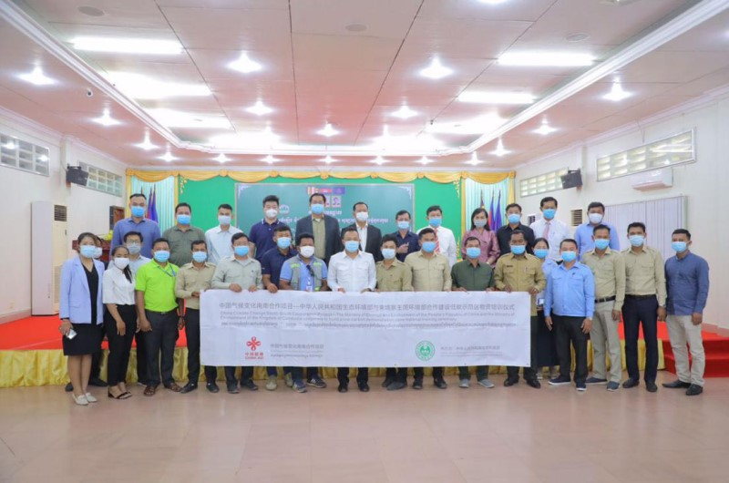
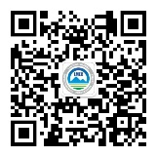
澜湄环境合作简报
MEE signed with its Cambodian counterpart the Memorandum of Understanding between the Ministry of Ecology and Environment of the People's Republic of China and the Ministry of Environment of the Kingdom of Cambodia on Cooperation to Build a Low-carbon Demonstration Zone in November 2019. China will help Cambodia improve its capability to respond to climate change by providing equipment and materials including solar street lights, photovoltaic power generation systems, electric motorcycles and environmental monitoring equipment, offering capacity-building training, and jointly developing the plan for building a low-carbon demonstration zone.
The Chinese side stated that China has actively implemented the national strategy for addressing climate change, promoted international cooperation on climate change, and provided support for other developing countries to improve their capability to address climate change by implementing a series of South-South climate cooperation projects. The Cambodian Low-carbon Demonstration Zone is the first low-carbon demonstration zone project constructed with China's involvement.
The Cambodian side spoke highly of China's efforts and contributions in developing South-South climate cooperation. These equipment and materials provided by China will be put into use in Sihanoukville Port, which is of great significance for driving local green, low-carbon and sustainable development and enhancing Cambodia's capacity in tackling climate change. In the future, Cambodia will continue to work hand in hand with China and make new progress in cooperation in the field of environment and climate change.
Contact Us
Lancang-Mekong Environmental Cooperation Center
Foreign Environmental Cooperation Center, Ministry of Ecology and Environment
5 Houyingfang Hutong, Xicheng District, Beijing
Postal Code: 100035
Tel: +86-10-82268277/8221
Fax: +86-10-82200579
E-mail: tang.huaqing@fecomee.org.cn
li.xia@fecomee.org.cn
Website: http://www.mepfeco.org.cn
WeChat Official Account: lancang-mekongec
About LMEC: Lancang-Mekong Environmental Cooperation(LMEC), established in 2017 in Beijing, China, aims to boost the capacity of environmental governance of each country and achieve regional sustainable development through the promotion of environmental cooperation among the Lancang-Mekong Countries.

