Slide 1
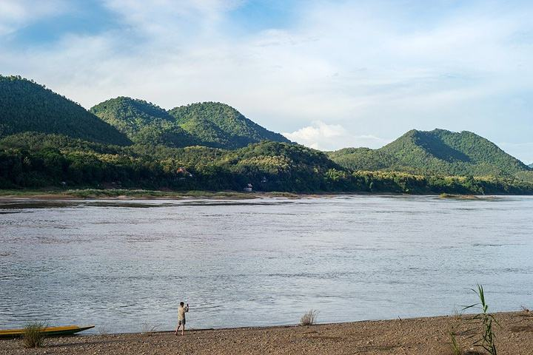

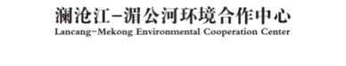

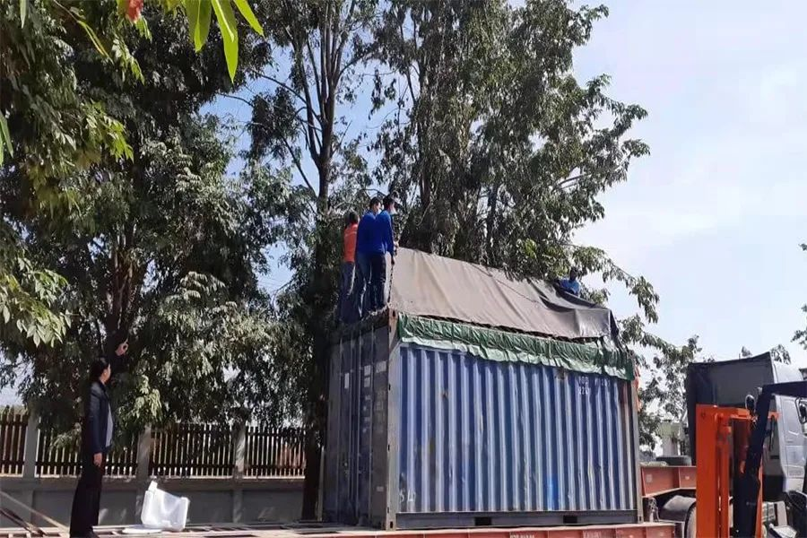
Newsletter
Issue 1, 2021 Jan. 7, 2021
Green Lancang-Mekong Initiative:
China-Laos Automatic Atmospheric Environmental Monitoring Demonstration Equipment Arrives Vientiane
The Lancang-Mekong Environmental Cooperation Center (LMEC) is actively implementing the Green Lancang-Mekong Initiative, with a bid to improve the environmental governance capabilities of Lancang-Mekong countries and jointly promote green and sustainable development of the region. The China-Laos automatic atmospheric environmental monitoring demonstration project is a part of the “Green Lancang-Mekong Initiative”.
Recently, with the support from the special fund for Lancang-Mekong Cooperation (LMC) and funds from enterprises concerned, the equipment for continuous automatic monitoring of air quality supplied by the LMEC to the Ministry of Natural Resources and Environment of Laos has arrived Vientiane. The equipment will be housed in the Laos National Convention Center, according to a plan.
Photo: scene of the workshop at LMEC

Slide 2
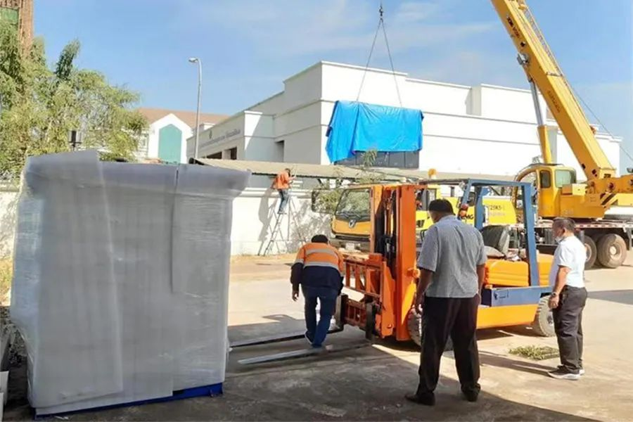
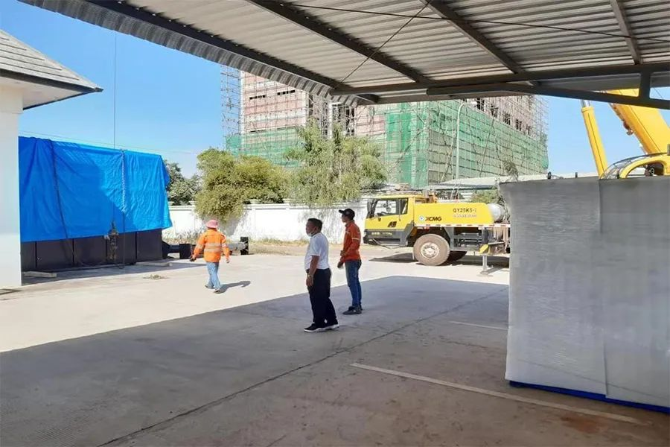
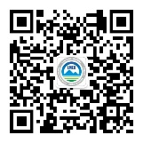
澜湄环境合作简报
The project will involve the launch of a pilot project on automatic air quality monitoring and professional training for personnel engaged in automatic atmospheric environmental monitoring in Laos, thus setting an example for atmospheric environmental monitoring in Laos, enhancing the atmospheric monitoring and management capabilities of Laos and improving urban ambient air quality there.
Looking forward, the LMEC will continue to implement the “Green Lancang-Mekong Initiative” and, through key projects such as regional response to climate change, clean air and clean water, drive Lancang-Mekong countries to improve their governance capabilities in coordinating addressing climate change and air quality improvement, managing sustainable infrastructure and ecosystems, and ensuring sustainable management of the water environment. By doing so, the LMEC will promote regional sustainable development and continue the profound friendship featuring “Shared River, Shared Future” among Lancang-Mekong countries.
Contact Us
Lancang-Mekong Environmental Cooperation Center
Foreign Environmental Cooperation Center, Ministry of Ecology and Environment
5 Houyingfang Hutong, Xicheng District, Beijing
Postal Code: 100035
Tel: +86-10-82268277/8221
Fax: +86-10-82200579
E-mail: tang.huaqing@fecomee.org.cn
li.xia@fecomee.org.cn
Website: http://www.mepfeco.org.cn
WeChat Official Account: lancang-mekongec
About LMEC: Lancang-Mekong Environmental Cooperation(LMEC), established in 2017 in Beijing, China, aims to boost the capacity of environmental governance of each country and achieve regional sustainable development through the promotion of environmental cooperation among the Lancang-Mekong Countries.

